Slide 1
Noticing and responding to concerns of child sexual abuse
Session Three

Slide 2
What we will cover today
The signs and indicators of child sexual abuse
What prevents us communicating with children about sexual abuse?
Communicating with children when we have concerns
Supporting children who have been sexually abused
The barriers children face in communicating about sexual abuse

Slide 3
Signs and indicators
Practitioners need to have a better understanding both of the impact of intrafamilial child sexual abuse and how a child’s distress resulting from abuse may show in their behaviour, and recognise the need to provide support that responds to children’s needs
The Child Safeguarding Practice Review Panel - I wanted them all to notice
Notes:
The information on this slide is taken from this report The Child Safeguarding Practice Review Panel - I wanted them all to notice

Slide 4
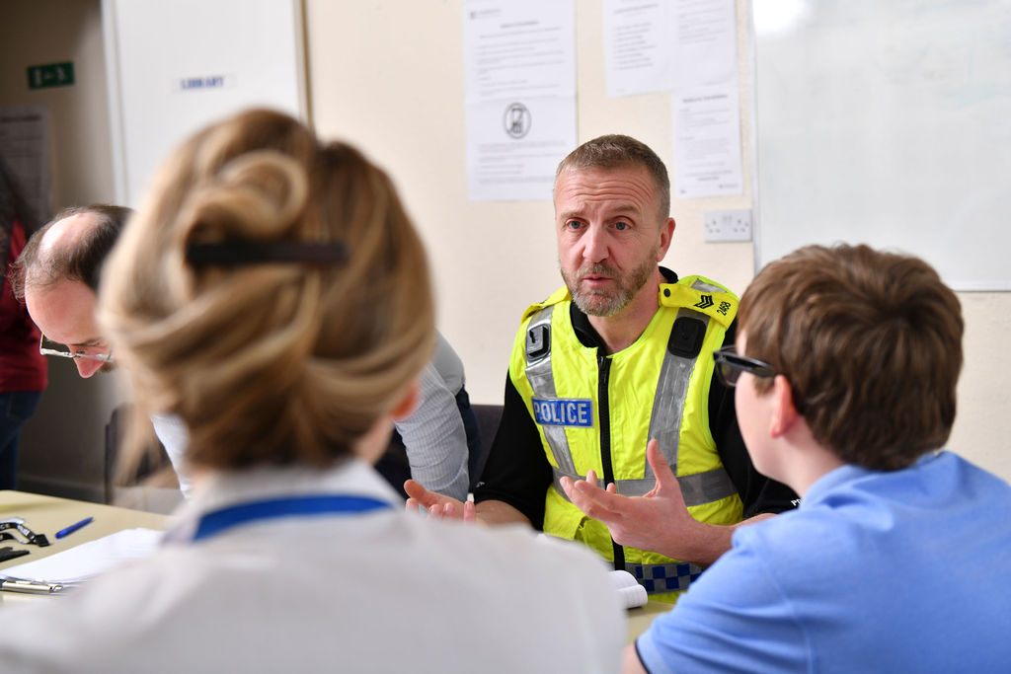
The evidence: Sexual abuse is rarely ‘clear cut’
How can we ‘absolutely know’ abuse has taken place?
Clear disclosure…repeated at least twice
Medical evidence of sexual harm
Admission of guilt from perpetrator
Witnessed by someone else
Images/computer records of the abuse exist
Rarely will we reach a position of ‘absolute knowing’
Notes:
How we would ‘definitely know’ beyond reasonable doubt that sexual abuse has taken place – take a moment to consider and make a note of your ideas.
AIM: To help people think about what we mean when we say ‘we haven’t got the evidence’ – see blog which explains this further and may be shared with the group at the end of the introductory day.
Useful reading/viewing for facilitators:
http://www.csacentre.org.uk/resources/blog/the-myth-of-absolute-knowing/
Don’t reveal the list on the slide until the end of the exercise.
Sometimes people will offer an answer that doesn’t fit this criteria, for example, that the child is sexually touching other children. In these circumstances it is useful to say, ‘yes that is indeed a strong indicator, but what might we say another cause may be for this?’. They will usually then come up with the other reasons we give, e.g. ‘they saw it online’.
Most often, they are able to come up with each of the points on the slide. As they do this, it is an opportunity to educate, as follows.
REVEAL the following AFTER DISCUSSION – Stating how rare they are …
Clear Disclosure Of Sexual Abuse…repeated at least twice – yes, and sometimes more than twice, with good recollection of detail (e.g. what they were wearing and where they were) – even though trauma affects recall. They need to say it when they first disclose, then to the police/social worker, then on video, then in evidence in court
Medical Evidence Of Sexual Harm – ‘yes, and how often do you think we get medical evidence of sexual harm? How many of you have received a report from a paediatrician saying there is medical evidence of sexual abuse?’ The majority of reports come back with an ‘inconclusive’ finding – why do you think that is?
1.Children usually take some time to disclose their abuse
2.The younger the child the quicker they heal, so any injuries are likely to be gone by the time of the examination
3.In one study (cited in Taskforce Report, 2010) 93% of cases where penetration was proved via other means, no medical evidence was found.
4.Sexual abuse doesn’t always cause physical harm – getting a child to touch themselves sexually, touching them sexually, masturbating over a child etc. – none of these would necessarily cause injuries.
Admission Of Guilt From Perpetrator – ‘yes, and how often do we think this happens? Rarely – There are strong barriers to a perpetrator of abuse admitting it –
Mental barriers that assist with denial and help the abuser to think of themselves as a good person whilst sexually abusing a child.
Losses in home, family, status, freedom etc etc
Witnessed By Someone Else ‘yes, and how often do we think this happens? Particularly with intra-familial CSA?
Most adults who abuse will do everything in their power to protect themselves from being found out – if they are they will lose their liberty, family, employment, self respect etc.. So they are unlikely to act abusively in front of others.
In some cases, siblings may witness the abuse, however defence lawyers often argue that the siblings somehow colluded with one another, thereby diminishing the quality of the evidence’.
Images/Computer Records Of The Abuse Exist ‘yes, and this is one area where there has been an increase in convictions, however many people who abuse would not risk taking images.
However, research also indicates that we as professionals often forget to ask the child during investigation whether any photos or other technology was used – thereby missing key evidence’.
Conclusion
So, despite the fact all of these are incredibly difficult to achieve, we continue to say ‘well, we haven’t got the evidence here’ as a reason not to continue to work with the family –
it is somewhat of a myth that we will gain this level of evidence, and yet we still use it to justify closing cases’.
Check the audience understand the point made.
Then advise them that in other sessions we will be considering evidence much more broadly – from the signs and indicators in the child, their family and the context of the abuse.

Slide 5
Building a picture of concerns
Signs and indicators in children
Vulnerabilities in the family environment
Signs and indicators of sexually abusive behaviour

Slide 6

Notes:
Video introducing the CSA Centre’s ‘Signs and Indicators’ template.

Slide 7
Avoid assumptions Especially those based upon:
Gender
Ethnicity
Religion
Disability
Sexuality
Notes:
The idea of this slide is to convey how we can miss signs of sexual abuse in some children because we make assumptions about what these signs mean as a result of certain demographics. These are all addressed in the template.
Gender and ethnicity
So, for example – a black boy presenting as aggressive may be seen as ‘an angry black boy’ rather than an indicator of sexual abuse.
Some groups of children are perceived by others to be less innocent or more adult-like than their peers – this is known as adultification bias and it is a form of racial prejudice. Adultification bias can influence how others view young people’s sexual development, for example sexually uninhibited behavior from Black girls or girls from gypsy/traveller communities dressing in a sexualized manner may be seen as ‘natural’ rather than an indicator of concern.
Disability
Or, a disabled child with unusual bruising we may put down to mobility issues, rather than sexual abuse.
Sexuality
Teenagers having sex with lots of people
Being secretive about online/mobile phone use or upset/angry afterwards

Slide 8
The aim of our resource
To create a common language among professionals to discuss, record and share concerns that a child is being, or has been sexually abused.
It aims to help you:
Consider, identify and clearly record signs which indicate that sexual abuse is or has been taking place
Discuss and explore concerns that a child is being or has been sexually abused, and communicate these concerns to other organisations and agencies
Do note, it is not a diagnostic tool, nor is it intended for use as a “risk assessment” or a “box-ticking exercise”
Notes:
Our signs and indicators template is designed to provide a common language among professionals to discuss, record and share concerns that a child is being, or has been sexually abused.
It’s natural to worry about getting it wrong, but even though we might hope it isn’t sexual abuse, and it might be difficult and uncomfortable to explore, we need to ask ourselves not what if I’m wrong, but what if I am right? What if this child is being sexually harmed?’ ‘What do we need to do, to make this child safer?’
As professionals in the children’s workforce, it is our job to be alert to wider signs and indicators that something isn’t right for a child and explore all possibilities of what might be happening to them.
In our ‘Signs and indicators of child sexual abuse’ template, you can record and make notes of the signs and indicators of concern.

Slide 9
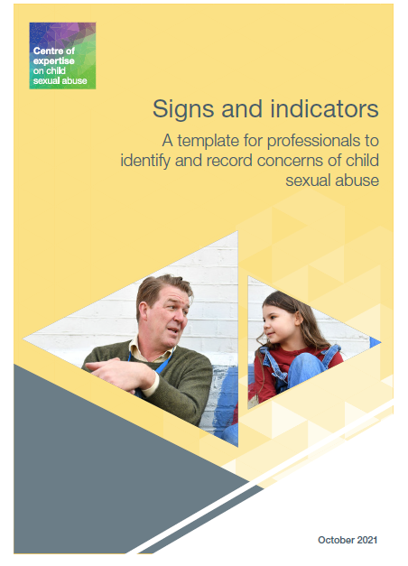
Try it in action
On your own…10 minutes
Read the case study relating to Simon, his family and his environment
Complete pages 7 – 16 of the Signs and Indicators Template
Think about how your agency could use the template
Notes:
Trainer note – use the group discussion to think about any ideas the group have as a lead in to the next slides
Signs & Indicators Template - CSA Centre link might need to be opened on separate page
https://www.csacentre.org.uk/app/uploads/2023/09/Signs-and-Indicators-Template.pdf

Slide 10

How might your agency use the template?
Record
Guide
Inform
Support
Educate
Formulate
Improve
Notes:
Some ideas are presented here
Record concerns about a child or family
Guide strategy discussions, supervision session, intervention planning, ABE planning
Inform decision making
Support during supervision, escalations, decision making
Educate during CPD sessions
Formulate a referral
Improve our response
Children’s Social Care
To inform discussion at a strategy meeting
To identify gaps in knowledge about a child and their living situation
To gather evidence of signs and indicators to inform next steps
As a recommendation by Conference Chairs/IROs when a clear picture regarding child sexual abuse does not emerge but concerns are sufficient.
To gather evidence to identify if further action can be taken (e.g. move to s.47, referral to MASH, seeking legal advice)
To support learning about signs and indicators of sexual abuse within staff training sessions/CPD opportunities
Education
Most education settings will deliver a Safeguarding update for all staff on an INSET day at the start of the new school year. The S&I template could be shared as part of this CPD session.
On-going CPD throughout the year with pastoral staff, form tutors, class teachers & heads of year
Training for governors & trustees – especially the Governor with the lead for safeguarding
Included as part of the safeguarding induction process for key members of staff
Many schools have online platforms to record safeguarding concerns (My Concern & CPOMs are two of the most established. The S&I template could easily be added into the document library on these platforms)
Many LA's have DSL networks & also deliver the DSL refresher training where the template could be introduced/considered
Health
Useful for health visitors and midwives (especially community midwives and those in homebirth teams) who will see the whole family in the home
Useful in general consultation with GP who might be GP for the whole family
All staff in children’s hospitals
CAMHS & adult mental health
Community mental health teams who will be visiting the family home will be in a great place to notice signs & indicators in all areas
Staff in in-patient units (especially well-placed are in-patient units for families)
Family therapists – lots of the info they will gather in a case formulation will transfer across/from the template
Useful in referral discussions (e.g. in West Midlands Youth First do most of their work via detailed case discussions with a number of different professionals – having the template at that meeting would be a great resource)
Forensic CAMHS services
Policing
The template can be used by police officers both pre and post – event. There is an assumption that the police always tend to turn up after the event BUT so often the police have had other involvement before the event.
Explain how it can be used in reverse (if they have attended post event) by noting what people have said POINT 1 on slide perhaps about behaviours prior to the disclosure. This can be recorded and passed on to the investigating officer.
The template will help them think about what the signs are across all 3 domains – Behaviour of the child/young person – Behaviour of those around the child – Environmental vulnerabilities - and provide clarity around the gaps they need to fill i.e. speak to the non-abusing parent, speak to the school etc.

Slide 11
What actions can you take?
Does your organisation / agency hold further information which could be added?
Does the picture indicate that further exploration with the child or their parents / carers is needed?
Does the picture indicate a level of concern that warrants a prompt safeguarding referral?
Does the picture indicate a level of concerns that should be shared with other key professionals in your agency?
Is further monitoring of the situation needed?
Notes:
This slide gives an overview of the information at the end of the template about what actions you can take after you have completed the template

Slide 12
“I think the situations where it's been disclosed and we've been asked to assess it, then records are clear. And then the situations where you might suspect, I don't think we could do that…I don't think professionals would be able to record that but I might be wrong, but how could you?”
Local authority social worker
Notes:
This slide is intended as an introduction to the following 2 slides about recording. The quote demonstrates concerns about recording concerns of child sexual abuse, especially if the child has not verbally told anyone. It is a good opportunity to remind participants that we cannot expect children to verbally tell us about abuse

Slide 13

Recording concerns Group discussion
What are the issues in relation to recording sexual abuse concerns?
What do you worry about?
How do you record concerns?
Notes:
Opportunity for group discussion – really important that people record their concerns (see next slide) – as otherwise we continue the silence around sexual abuse, even in children’s files.
Likely to be some discussion here in relation to the terms ‘disclosure’ and ‘allegation’ – there have been court rulings that have been concerned by the use of ‘disclosure’ in court bundles – arguing that where the social worker uses this language, the investigation has been biased, as they have assumed the allegation is true. There has also been a fairly vocal group of solicitors who have argued against the term disclosure – there is a quite a history on this, including battling with NSPCC who vehemently disagree. See two links here on the discussion arguing against the term:
https://www.childprotectionprofessionals.org.uk/our-language-matters-why-we-should-stop-using-the-term-disclosure-in-child-protection
https://transparencyproject.org.uk/why-words-matter-the-debate-about-disclosure/
After much deliberation – we now advise: rather than using either the term ‘disclosure’ or ‘allegation’, social workers record simply “The child said…” This gets away from any legal wranglings over the use of the term, is totally factual and doesn’t imply we believe or don’t believe – this is particularly important for people who access their records as adults.
(The term disclosure does also have different implications in the criminal justice/court arena, so that adds confusion).

Slide 14

Recording
Professional judgement
Substantiated either by fact, or backed up with evidence from what has been seen or heard
Opinion is recorded as such
Reasoning, analysis, conclusion
I am concerned that X and Y may be being sexually abused. This is because of the following:
List potential indicators (in child, people around the child, environmental factors)
These may be signs of other factors in X and Y’s life, however in order to explore this hypothesis, I will:
List actions that you have identified e.g. speak with other agencies, speak with X and Y.
Notes:
Recording.
https://www.scie.org.uk/social-work/recording
https://www.communitycare.co.uk/2017/06/07/tips-social-workers-case-recording-record-keeping/
(see https://www.scie.org.uk/social-work/recording and https://www.communitycare.co.uk/2017/06/07/tips-social-workers-case-recording-record-keeping/ )
links may need to be opened on separate page

Slide 15
“Safeguarding decisions must be based on all indicators of sexual abuse and should not rely solely on verbal statements from children”
An extract from National Recommendation 3 – The Child Safeguarding Practice Review Panel – I wanted them all to notice (2024)
Notes:
The Child Safeguarding Practice Review Panel - I wanted them all to notice

Slide 16

Break
Notes:
Trainer reminder – take a register

Slide 17
Communicating with children

Slide 18
“Professionals rely too heavily on children to verbally disclose”
Report into Child Sexual Abuse in the family environment JTAI 2020

Slide 19
Why is this important?
We struggle to recognise our own important role in children’s communication
We are just not very good at it – research continues to show high rates of delayed disclosures
Timely access to support services can mitigate risk to the health and mental health well-being of children, youth, and adults
We can prevent further sexual victimisation
Notes:
Why is this Important?
Simple read through of slide.

Slide 20

Exercise…
Notes:
AIM of the Exercise: DO NOT TELL THEM THIS AT THE START!
This is an experiential exercise in which the participating workers are asked to think about how it feels to consider telling someone about an experience they don’t want to share.
The decision to tell someone that they are being abused is a massive step, which is likely to have far-reaching consequences. Children (and adults) worry about a multitude of things when thinking about whether to tell or not. This exercise aims to:
Encourage participants to feel how difficult disclosure is for children;
Explore the breadth of different concerns children may have about telling;
Consider what they can do in their own practice to support the disclosure process.
Instructions:
The group facilitator needs to give the following instruction:
“We’re going to do an exercise to explore children’s disclosures.
I’d like you to write down a couple of sentences about a sexual experience you have had.”
There is likely to be tension in the room/virtual room throughout this exercise. When in the room, there is often some laughter and other evidence of discomfort, also people talking to one another about it. After a period of this, ask everyone to focus on doing the exercise on their own. Some people may ask things such as ‘does it need to be a good or a bad experience?’, to which you can just repeat the instruction, or say it can be any experience.
Give participants around 2 – 3 minutes to write down their sexual experience. Then give the following script:
Now I am going to randomly select a few people to share what they have written with the rest of the group.
Pause for a few seconds before you let them know that you are not going to make anyone share this information
The next part of the exercise explores the feelings (physical and emotional) that people felt during that exercise. Some prompts are as follows:
How are you all feeling?
How did you feel when I asked you to write down something you didn’t want to share?
Where did you feel these feelings in your body? E.g. increased heart beat, stomach dropping, flushing.
What thoughts did you have about where the exercise was going?
How did you choose what to write? (Did anyone write nothing? Give scant information? Make something up? Think of a number of different things before deciding on one?)
Did you wonder where your information may be going?
This discussion will have pulled out a number of the thoughts, feelings and concerns that children (and adults) will experience when thinking about whether to tell. Ask people to think about how much more difficult this would be for a child who has been sexually abused.
For the final part of the exercise ask participants to think about how the ways in which this exercise could help us in our practice with children, for example, it would be useful for them to know where sensitive information would go, were they to share it.
Spend the last few minutes of the exercise checking in with all participants and acknowledging that that can be a powerful exercise to undertake.

Slide 21
“There were so many times when I thought about telling someone but it was just like, how do you bring it up? How do you just walk into a room and go to someone, ‘oh by the way this happened’?”
Making Noise (2017): IV29, Female 18 years

Slide 22
Barriers for children
Lacking language
Don’t recognise it as abuse
Shame or embarrassment
Threat or manipulation
Fear of the consequences
Feeling responsible
Notes:
Studies with children and young people, and retrospective studies with adult survivors, have identified a number of factors which affect a child’s willingness and capacity to disclose CSA. These include:
the child’s relationship with the abuser
how old they were when the abuse first happened
the type and severity of the abuse
demographic variables such as ethnicity and gender.
Given that Intra-familial CSA involves people who feel like family to the victim, and typically starts at a younger age than extra-familial abuse, it is likely to be of particular concern in relation to disclosure.
(McElvaney, 2016; Allnock and Miller, 2013; Warrington, 2017; Allnock, 2010; KMFR, 2018)

Slide 23
“People don’t talk about it” Child sexual abuse in ethnic minority communities, (IICSA, 2020)
Societal & Institutional Influences
Education and awareness
Media
Stigma associated with child sexual abuse
Stereotyping and racism in society
Institutional racism
Inaccessible services
Lack of culturally-sensitive services
Identification and disclosure
Responses to child sexual abuse
Support for the victim and survivor
Differences in understanding of child sexual abuse
Ideas about gender
Shame
Honour
Pride
Secrecy and denial
Mistrust of institutions
Community reputation prioritised of victim’s needs
Community Influences
Notes:
See report - https://www.iicsa.org.uk/publications/research/child-sexual-abuse-ethnic-minority-communities

Slide 24
Barriers to telling based on the child’s background or characteristics
Some children may face additional barriers based on their background or characteristics.
Some professionals may make assumptions about children in some of these groups, overlooking the possibility that they may be being sexually abused.
Group activity (10 minutes)
What might create additional barriers for children in communicating what is happening to them?
Notes:
Some children – such as boys, d/Deaf or disabled children, minority ethnic children and those who are lesbian, gay, bisexual, trans, questioning, intersex or asexual (LGBTQIA) – may face additional barriers based on their background or characteristics. Additionally, some professionals may make assumptions about children in some of these groups, overlooking the possibility that they may be being sexually abused.
Group activity
Divide the group into 6 small groups (if the whole group size is small you can divide into fewer groups)
Ask them to think about what might create additional barriers for some groups of children. Ask the group to assign someone to take notes and someone to feed back at the end
The next group of slides will address some of these additional barriers

Slide 25
Who was told at the time Rape or penetrative abuse
(ONS 2020)
Notes:
This data shows us that at the time – children are extremely unlikely to tell – and more so if the abuse is penetrative. If children do tell, they are more likely to tell someone they know personally (e.g. a non-abusing parent for younger children, a friend for teenagers), than anyone in a professional role. We also know that Boys are far less likely to tell than girls.
The percentages don’t add up to 100 because respondents could tell several parties, i.e. family/friends as well as a professional. Looking at this data, it is clear that most males who did tell, told someone in their family or friends; and then some also told a professional. Among females, all told family or friends, and some also told a professional.
When you have presented what is on the slide, move on to the next slide to ask the group to think about what we can do to change this
Office for National Statistics (2020) Child Sexual Abuse in England and Wales: Year Ending March 2019. Titchfield: ONS.

Slide 26
Who children told
In 72% of reviews there was evidence that the child had told someone about the abuse, sometimes on multiple occasions
The Child Safeguarding Practice Review Panel - I wanted them all to notice
Notes:
This slide presents data from the National Panel report “I wanted them all to notice” The Child Safeguarding Practice Review Panel - I wanted them all to notice
In 98 (72%) of reviews, there was evidence that children had told someone about the abuse, sometimes on multiple occasions, although it was not always clear who they had told.
When this information was clear, it seemed that:
• 26 children had told a family member (often their mother, but sometimes a brother, father, grandparent, aunt or uncle)
• 12 had told a friend (either a peer or an adult family friend)
• 10 had told a residential worker or foster carer
• 9 had told a teacher or nursery worker
• 4 had told a health professional (such as hospital staff, or a therapist)
• 3 had told a social worker or student social worker
In addition, in over a third (40%) of reviews, another child or adult had reported the abuse of the child to someone

Slide 27
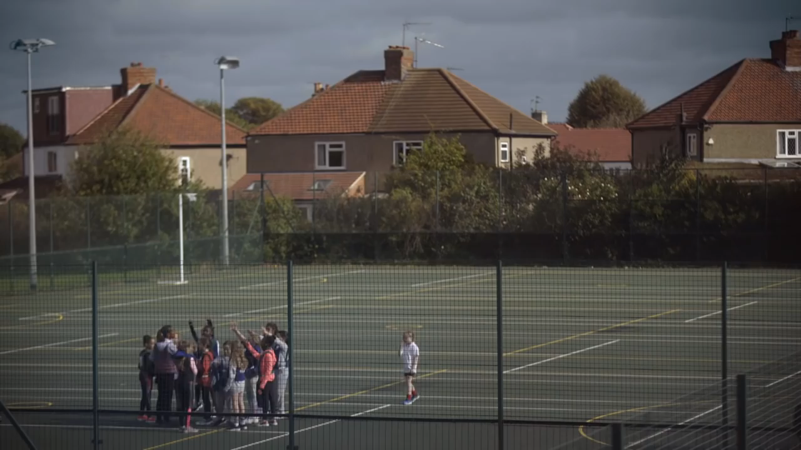
Notes:
Say something NSPCC
Some participants may have seen this advert previously, however it is a useful one to play to remind people of the mirroring of anxieties in professionals and children – and the need for us, as adults, to help children tell.
Here is the YouTube link to video if needed.
NSPCC TV ad, 'Say Something' 60 SEC – YouTube
https://www.youtube.com/watch?v=VrAwP79Dmn8

Slide 28
“I wanted them all to notice” National Recommendation 5 Talking to children Government should ensure that practitioners understand that they can and should talk directly to children, and families, about concerns of sexual abuse
The Child Safeguarding Practice Review Panel – I wanted them all to notice (2024)

Slide 29
Understanding how children communicate about sexual abuse
Notes:
This resource was published in February 2022 and the link is here - http://www.csacentre.org.uk/knowledge-in-practice/practice-improvement/communicating-with-children-guide/
This link may need to be opened on separate page

Slide 30
Children need help to tell
We think about disclosure as the act of a child telling someone (i.e. a one-way process)
This one directional view does not recognise the relational and social-interactional context of disclosures.
Sender
Message
Receiver
Notes:
Children need help to tell.
Trainer Note - Display slide and give brief description.
We see children’s disclosures as a one way process – they give us info, we receive it….however…This one directional view does not recognize the relational and social-interactional context of disclosures.

Slide 31
Our role in the process
Instead, disclosure develops through an interplay between children’s signs and expressions and the reactions of the adults around them
Children receive information on how adults respond to them, they process and evaluate this information, and they base their reactions on this
Message
Sender
Receiver
Response
Notes:
Disclosure is a two-way process - An Interpersonal And Interactive Process Between Children And Adults.
Disclosure is a relational process, which is renegotiated by each interaction and evolves over an extended period of time.
It is a life long process from the moment abuse starts, through behavioural and verbal clues and on.
The characteristics and reactions of the interaction partner appear to be as critical to this process as the behaviour and words of children themselves. How we act counts!!
Therefore – we as professionals are as critical to the disclosure process as the children themselves.

Slide 32
Containing the secret and the ‘pressure cooker’ effect
There are three key dynamics in the process of ‘containing the secret’, whereby children and young people:
Actively withhold the secret (for fear of the consequences of telling)
Are torn between needing to tell (to make the abuse stop and to get support) and wanting to keep the secret (for fear of the consequences of telling) – the ‘pressure cooker effect’
Confide in the context of a trusting relationship.
It is important to understand the emotional struggle of the second stage, in order to be able to support children and young people empathically, respectfully and patiently through their disclosure journey.
(Rosaleen McElvaney, 2012, 2016)
Notes:
Containing the Secret and the Pressure Cooker Effect.
Simple read through of slide.
The following article explains McElvaney’s idea around the ‘pressure cooker effect’:
Containing the Secret of Child Sexual Abuse. Journal of Interpersonal Violence, 27(6) 1155 – 1175. McElvaney, R., Greene, S., Hogan, D. (2012)
It is useful for practitioners to think about this process to inform their work with children – for example, during stage two (the pressure cooker effect), children are torn about whether to tell or not – so if we think about this as professionals, then we can think about what they may need to hear from us to help them to problem solve in this situation.

Slide 33
Talking about sex Reflection
What were the messages you received about sex and sexuality growing up from:
Family
Peers
Partners
Community
Church
Society
What were the influences on you? How does this affect your ability to respond to children and young people talking about their experiences?
What stereotypes and biases do you hold?
Do you think you ever engage in victim blaming?
How comfortable are you talking about sex? Think of it on a scale of 1-10.
We are not going to ask where you are on the scale…but we probably all need to feel more comfortable.
How can this change for you?
Notes:
Ask the group to reflect on this on their own for a few minutes. Invite people to share anything that they feel comfortable in sharing.

Slide 34

And then….
What do you know about the children and families you work with…
Attitudes to sex?
And sex education?
Knowing what body parts are called?
Sexual boundaries in the home?
Cultural and religious attitudes?
Attitudes to women?
Attitudes to sexuality and choice?
This is an important CONTEXT when thinking about sexual abuse and children
Notes:
Go into breakout rooms for a 5 minute discussion on how comfortable we feel about gathering this information, bearing in mind the group’s previous individual reflections

Slide 35
How can we do it?
Our Communicating with Children guide can help

Slide 36

Notes:
The video shows the introduction to the Communicating with children resource

Slide 37
Giving children the confidence to tell
It is a very powerful motivator for young people to disclose if an adult takes notice of their struggles and asks about them.
“When someone noticed the signs and impact of abuse and asked about it”
(No one noticed, no one heard (Allnock and Miller, 2013)
Notes:
This slide looks at the findings from ‘No One Noticed, No One Heard: A study of disclosures of childhood abuse’ (Allnock and Miller, 2013) on what prompted young people to disclose.
When someone noticed the signs and impact of abuse and asked about it - It is a very powerful motivator for young people to disclose if an adult takes notice of their struggles and asks them about them.
Useful to highlight to participants that this is well within all of our capacity.
For some it was when asked a direct question
For others through building trust by providing a safe place to talk
Consider which might be best for the child and you and try both…..
The study also identified the following factors which prompt disclosure:
1. Developmental Changes And Learning – for some, entering puberty and developing fears around pregnancy meant they told, for others having sex education at school and realising they were experiencing abuse
2. When They Could No Longer Cope – for some, just feeling that they could take no more, and in weighing it up, telling felt like the best option- Feeling like a pressure cooker holding unto the secret
3. Escalating Violence In The Abusive Acts – for some, when they felt the abuse was becoming more serious, for example moving towards penetration or rape.
4. To Protect Others From Similar Abuse – a particularly common point where children, young people and adults tell in order to protect siblings or other family members

Slide 38
Opening a door
Comment rather than interpret – “I notice you crying”
Open a door – “I am here”
Be aware of your body language
Give the child time “I’m going to come and see you again next week and we can talk a bit more about this if you would like to”
Use resources - “I’m going to show you an online resource so that if there is something that is worrying you, you can work out how to get some help”
Give them an alterative - Suggest a third person example and talk about that person. E.g. If you had a friend who was experiencing something difficult, what do you think would stop them telling? Or help them tell?
And……….
Notes:
I will talk more about each of these in the next few slides

Slide 39
Let them know what will happen if they tell “The only grown up that spoke to me about what would happen if I spoke about my abuse was the person who was abusing me.”
(May Baxter-Thornton)

Slide 40
Taking a graduated approach
“I have noticed you don’t seem yourself at the moment”
“Help me understand”
‘Sometimes we worry about what may happen if we tell someone what is going on (e.g. that we’ll get into trouble/that we’ve been told to keep it a secret/that we’ll upset people) – can you tell me what you are worried may happen if you tell someone what is going on?’
“Can you tell me more about that”
“I have noticed you shouting a lot at the moment”
“I have noticed X and would like to understand more about that”
‘Sometimes things happen that young people find really difficult to talk about”
“I notice you are very quiet at the moment”
Notes:
Suggested script
In situations where the child has not told you that they are being or have been abused, but they may recently have become unusually quiet and withdrawn, bullied other children, displayed sexualised behaviour, or showed signs of distress or other signs which could indicate sexual abuse, “I have noticed” statements are useful in demonstrating to the child that you are thinking about them and holding them in mind.
The child may or may not respond to you at this point and it is important that you don’t expect to receive a response. However, you may want to say more to open up a conversation and you may choose to say things like:
Help me understand
Can you tell me more about that
I have noticed X and I wonder what might be going on for you at the moment
I have noticed X and would like to understand more about that

Slide 41
Continuum of question types
General invitations | Cued invitations | Open ended questions | Closed ended questions | Option posing questions | Suggestively worded questions
Open questions inviting the child to tell in their own words unprompted, encouraging longer answers | Open questions using a cue from the child or undisputed facts | ‘Who’, ‘what’, ‘when’, ‘where’, ‘how’ questions which invite a narrative | ‘Who’, ‘what’, ‘when’, ‘where’, ‘how’ questions which can be answered in one word or a few words | Questions that can be answered “yes” or “no”, or that prompt the child to select from given choices | Questions that force the response in a specific direction, or use false or unknown information
Notes:
There will likely be times when you need to ask more direct or specific questions. This continuum of question types can help you think about how to adapt your questioning style to meet the needs of the child and
The continuum ranges from very open general invitations (“tell me…”) to biased or suggestive questions where the answer is presupposed by the adult (“he hurt you, didn’t he”)
General invitation
Thought to give the most accurate responses. However, younger children (under 5) may struggle with general invitations and may need more directive questions to be able to tell. So, for example, younger children may need more cued invitations……
Cued invitation
Open invitation using undisputed facts from the child (“you said he hurt you……tell me more about that”) – these need to be undisputed facts from the child’s own words so you would only use this specific example if the child used the words “he hurt me”. Younger children may need this kind of scaffolding
Open-ended directive
W questions which invite a narrative (“what else happened?”) – these may help children aged 3-5 but you need to make sure the child understands the complexity of the question
Closed-ended directive
W questions which can be answered in one or two words (e.g. where did he touch you?”) – be careful not to ask questions that assume (e.g. asking “who else was there?” assumes that there was someone else present
Option posing questions
Be careful with these questions – offering choices that close down a range of other options can be leading and especially difficult for younger children to answer
Suggestively worded questions
To be avoided

Slide 42
Asking specific questions
To ensure the young person’s safety, you may need to ask them specific questions, particularly questions beginning with ‘who’, ‘what’, ‘where’ and ‘when’:
Typical questions might be
“Who will be at home when you go home later?”
“What else happened?”
Can you tell me where they touched you?”
“Tell me when that last happened.”
If the child has told you they have been hurt by someone but hasn’t given you enough detail to know who the person is, you may ask, “Can you tell me who that is?
Notes:
If the child uses ambiguous language (e.g., referring to “my flower”) you may need to clarify their meaning. You may say, “Children often use different words to describe things; can you tell me what you mean when you say ‘flower’?
Questions beginning with ‘why’ should be avoided ad they can sound blaming to the child and can be interpreted as accusatory
If you want to understand more about the reasons for a child’s fear of going home, for example, ask instead: “What is it you are afraid will happen if you go home?”

Slide 43
Not being believed… Taskforce (March 2010)
Children rarely give fictitious accounts about having been abused and false allegations have been found to be rare.
“The stigma of sexual abuse and trauma of disclosure should never be underestimated and the damage caused to children when they are not believed is immeasurable.”
Notes:
Not being believed.
Children are far more likely to not tell us what is going on, than make up something that isn’t.
43

Slide 44
Working with children who have been sexually abused

Slide 45

Recommendation 3: Enquiries and Investigations
Safeguarding partners to audit and review local guidance and practice so that a clear distinction is made between thresholds about significant harm to a child and those influencing criminal investigations.
The term ‘no further action’ should not be used in these circumstances as it is too often understood to mean the abuse did not happen. The term ‘no further police action at this time’ is more appropriate.
There should be a clear record of why a criminal investigation has been closed and that this information has been shared with other relevant agencies.
At the conclusion of section 47 enquiries and police investigations, there is a multi‑agency discussion to consider risk to the children and how they will be protected and supported.
Notes:
This slide is intended to introduce the importance of focusing on the child’s welfare whether a criminal investigation is pursued or not
Government should take necessary steps to improve the quality of joint enquiries so that decisions are more consistently in children’s interests.
This review reveals that the criminal standard of proof pervades decision making throughout the child protection system and beyond, which prevents many children who have suffered sexual abuse receiving the help and protection they need.
Responding to this should include:
requiring safeguarding partners to audit and review local guidance and practice so that a clear distinction is made between thresholds about significant harm to a child and those influencing criminal investigations. Safeguarding decisions must be based on all indicators of sexual abuse and should not rely solely on verbal statements from children.
make any necessary changes to Working Together guidance to clarify that a section 47 enquiry concludes when the multi‑agency group who have led the enquiry decide together if there are outstanding concerns, and if so, to notify relevant agencies so that any necessary actions needed to safeguard the child and/or other children can be considered.
when applicable, that the child’s records should state ‘no further police action at this time’, with an appropriate explanation, instead of ‘no further action’. Too often when the police record that they are taking no further action it is understood by other professionals to infer that the abuse did not happen.

Slide 46
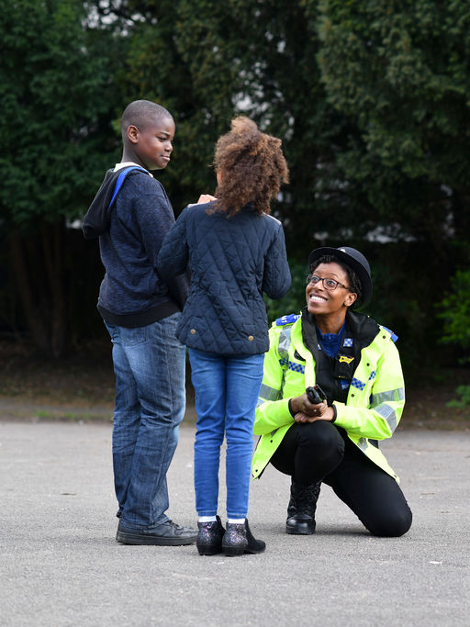
Investigation and support
The child’s wellbeing MUST always be the main priority, not the effect that supporting a child will have on the investigation.
If an investigation is launched then the child MUST be supported to ensure their wellbeing, both physical and emotional, are met.
This needs to run ALONGSIDE a police investigation not after the police investigation.
Whilst there is police investigation ongoing there is no need for anyone supporting the child to ask any direct questions about what has happened but if the child offers up further information as trust builds, then that should be passed on to the police.
Regular investigation updates from the police to the social worker should be passed on to the child/family if appropriate.
Notes:
Police and Children Services can work in tandem to support the child and their family alongside other agencies.
Therapeutic or other support should not be withheld because of a criminal investigation – CPS guidance is clear that the decision to offer therapeutic support to the child should be made on the basis of the child’s best interests, not the impact of it on the investigation. See further info at :
Pre-Trial Therapy | The Crown Prosecution Service (cps.gov.uk)
Do not speak to the child about what has been disclosed by them during the investigation – i.e. detail of their Achieving Best Evidence interview.

Slide 47
Key messages on pre-trial therapy
Therapists and victims are encouraged to jointly agree on what type of therapy is best and when is the right time for such therapy. Neither the police nor the CPS may decide this.
If a victim decides therapy would be helpful for them, it should not be delayed for any reason connected with a criminal investigation or prosecution.
The CPS guidance explores the benefits of therapy for victims engaging in the criminal justice process.
Certain therapeutic approaches are not recommended due to the impact they may have on criminal proceedings.
Therapy notes can be requested by the police or prosecution if justification is given that they form part of a reasonable line of enquiry and with the consent of the victim (or their parent/carer).
Therapists, investigators and prosecutors must comply with data protection legislation when processing therapy notes.
Only in exceptional circumstances can a court order the release of notes against the wishes of the victim (or their parent/carer).
Taken from the Bluestar project
Notes:
Bluestar_Pre-trial-Therapy-Protocol_S4V1.pdf (bluestarproject.co.uk)
Fundamental principles from CPS guidance
On the prioritisation that the guidance will give to victim health and wellbeing:
The health and wellbeing of the victim should always be the determinative factor in whether, when and with whom they seek pre-trial therapy.
It is for the victim to make decisions about therapy with their therapist, including what type of therapy is obtained and when that therapy is obtained. Criminal justice practitioners should play no role in the decision-making process beyond alerting victims to the availability of therapy.
It is paramount that all victims are aware that they can access therapy to ensure that their emotional and psychological needs are met before, during and after any potential trial. There is no requirement to delay therapy on account of an ongoing police investigation or prosecution.

Slide 48

Interventions for children
Trauma
Mental health (including sleep issues)
Sexuality, sexual development, sex education
How and why abuse happens
Self-esteem, assertiveness
Brains and bodies
Myth busting
Sexually harmful behaviour
Coping strategies
Online issues
Protective behaviours/keep safe work (NOT stand alone)
Notes:
Intervention for Children.
This slide presents a range of areas in which we can provide psycho-educative work to children about their abuse:
Protective behaviours/keep safe work (NOT stand alone – in some places these sessions are called ‘protective behaviour’ sessions, in others ‘keep safe’ sessions.
While these are incredibly useful in educating children about sexual abuse, no child has the capacity to protect themselves from abuse by an older person on their own, nor should they be made responsible for their own protection and safety.
Sometimes when we don’t know what to do with a case as we don’t feel we have the ‘evidence’, the only recommendation we make is for the children to have this work – this is not acceptable.
These sessions should always be in the context of other work with the family about who we are concerned, e.g. the non-abusing parent and should always include activities which are meant to keep the child safe.
This work tends to include the following areas:
Feelings and emotions; early warning signs; identifying a safe network; safe and unsafe; private and public; boundaries; secrets and suprises; unwritten rules; rights and responsibilities; online safety.
An example of a programme of work, including worksheets can be shared with interested participants.
Trauma – see earlier slide.
Mental Health (including sleep issues) – using the tools to find out how a child’s mental health has been impacted and then addressing those issues.
Sexuality, sexual development, sex education – abuse can leave children with many worries about their sexuality and development, and many do not have a good understanding of sex and healthy sexual relationships.
How and why abuse happens – helping children understand the grooming process can help them recognise that they are not responsible for the abuse – this can be delivered in an age-appropriate way.
Self-esteem, assertiveness – abuse impacts self-esteem and children’s capacity to assert themselves.
Brains and bodies – helping children understand trauma responses and sexual arousal can assist with confusion around how their body responded at the times of abuse.
Myth busting – see some of the common myths that children and young people hold about sexual abuse in ‘The Truth about Sexual Abuse’ by the National Child Traumatic Stress Network.
Sexually harmful behaviour – one of the key indicators of sexual abuse, in particular for young children, is sexually touching other children. This behaviour needs to be addressed as early as possible – if we don’t do this, it is likely to cause issues in school, home and placement. Session 6 will address this in more detail.
Coping strategies – helping children develop ways to cope with the feelings that arise from abuse will be very useful for them, and help prevent other issues (such as problems at school) developing.
On line issues – assessing a child or young person’s use of the internet (including pornography and social media) is important so that we can provide appropriate advice and support to them and their parents/carers.

Slide 49
Accessing support for ethnic minority communities Challenges
Not knowing where to go for support.
Understanding a non-judgemental approach – important for recovery.
Finding non-judgemental support was challenging, both from services and from informal family and support networks.
Many victims and survivors expressed a preference to receiving support from someone similar to themselves – either due to experience, ethnic group or gender.
“She understood not only as a black woman being abused, sexually abused. She ticked all my boxes. Everything I said she got me. And I realised how important, how much I needed that. Someone that I could look at, I recognised, but understood me.”
(Female focus group participant)
(IICSA, June 2020)
Notes:
Challenges of Accessing Support for Ethnic Minority Communities.
Many victims and survivors reported experiences of not knowing where to go and sometimes finding that support was just not available
The need to be able to share the experience of child sexual abuse with someone who understands and is not judgemental was cited by many participants as the most important support need for recovery.
Finding non-judgemental support was challenging, both from services and from informal family and support networks. In particular, a lack of understanding from family and community members highlighted the importance of access to appropriate statutory and voluntary support organisations.
Many victims and survivors expressed a preference for receiving support from someone similar to themselves. For some participants, this meant people with similar experiences of abuse. For other participants, this meant being from the same ethnic group or gender:
https://www.iicsa.org.uk/publications/research/child-sexual-abuse-ethnic-minority-communities
PDF Document provided in Reading List - “Independent Inquiry CSA”

Slide 50
“Sexual abuse is not an act or an incident but the corruption of a relationship.”
( Still, 2016, 44)
Notes:
This is intended to introduce the importance of family communication before moving on to the next slide

Slide 51

Opening up family communication
Sexual abuse happens in secret.
When grooming starts, good and open communication in the home environment is often the first casualty.
A major component of intervention with families where there has been sexual abuse is to help open up communication.
The protective parent/carer is central to this process – he/she will need to understand why and how communication was shut down in the first place and the effects on the child and on family relationships.
(Adapted from Jenny Still, Lucy Faithful Foundation)

Slide 52
Enabling conversations
Mum, do you think X knows how you feel about the fact your brother abused him?
X, what do you think mum thinks about the fact you told your teacher about the abuse?
What do you think your brothers and sisters may be feeling about what has happened?
What would you like X to understand about your feelings on what has happened?
There’s been some strong feelings in the family since this came out, what worries do you have about this?
Mum, what do you think Dad feels about what your father did to your children? Do you think it has impacted on how he feels about you?
What are you most worried about for the family?

Slide 53
Supporting the whole family
Reduce risks and vulnerabilities and build strengths
Address individual and relevant risk factors (e.g. alcohol/drug use or mental health)
Relationships
Family communication
Address individual needs (e.g. supportive & therapeutic intervention)
Education
Safety planning
Notes:
Areas for Intervention.
This is for the Trainer to demonstrate all the different areas that need to be worked on in intervention – and even if we don’t ‘definitely know’ that abuse has taken place, we can still work to reduce risk factors and build protective factors.
Address individual and relevant risk factors
e.g. alcohol/drug use or mental health – of both the alleged abuser and the non-abusing parent
Relationships
Couple relationship
Relationship between parents and children
Family communication
When sexual abuse takes place, good and open communication is the first casualty – so this needs to be a major focus
Address individual needs
e.g. supportive & therapeutic intervention for child
Education
Knowledge is power – need to educate the non-abusing parent about how this happened, NOT JUST THE CHILD (no child can keep themselves safe from an adult who wants to abuse them)
Safety planning
Not a written agreement – but a meaningful plan of how everyone in the family can be kept safe.

Slide 54
When there is no criminal investigation Supporting the family
There are a number of things we can do to safeguard and support children, regardless of if child is disclosing abuse
Use the Signs and Indicators Template to build a picture of your concerns
Explain your concerns to non-abusing parents/carers to help them understand why you are worried
Educate non-abusing parents/carers about sexual abuse and sexually abusive behaviour
Support the family to create opportunities for their child to confide in them
Address vulnerabilities in the family in order to decrease the risk of sexual abuse taking place
Devise a safety plan with families to minimise the chances of sexual abuse happening in the future
Help children to think about who they may tell in the future, and share the Childline number/website with them
Educate children about sexual abuse so they know what abuse is and what they can do about it (this should never be the only thing you do)
Notes:
Emphasise that a child telling someone about sexual abuse is a process, not a single, one-off event. Helping children to tell over time is important.
If you think a child is being sexually abused but they have not told you this in words, then think about how you can reduce risk factors and increase protective factors within the whole family, and continue the conversation with the child to give them time to feel comfortable enough to tell.

Slide 55



Reflections
One thing you have learnt from this session
One thing you will share with your colleagues
One thing you will take forward in your own practice
Notes:
Ask the group to make a note of one thing they have learnt from the session, one thing they will share with colleagues, and one thing they will take forward in their own practice
Ask them to pick one of these to share in the chat
Give everyone 5 mins for this

Slide 56

Find a support service
Being able to access support, as a child, young person or adult, is crucial to mitigating the impacts of child sexual abuse.
To help make this easier, the CSA Centre has created a directory containing over 350 child sexual abuse support services in England and Wales.
The accessible, searchable Support Services Directory is a simple way for victims and survivors, their families, or professionals, to find services that can help.
Find support services and get help today.
csacentre.org.uk/get-support/
Notes:
People can search by location, or by clicking on a region on the map. It contains support services for all those who may be impacted by child sexual abuse, including children and young people, parents and carers, and adult victims and survivors of child sexual abuse.
It is completely confidential to access - no sign-up is required, and no information is saved when people search for support.
Those seeking help can also find local and national services offering focused support for women and girls, men and boys, LGBTQ+ people, disabled people and for people specifically from ethnic minority backgrounds.
It’s a particularly valuable tool for professionals working with those affected by childhood sexual abuse to quickly find and recommend support for the children and adults they work with.

Slide 57
Stop It Now Helpline
If you are worried about your own thoughts or behaviours or are worried about the behaviours of someone around you, you can contact the Stop It Now Helpline for free, confidential advice:
0808 1000 900

Slide 58
Thank you!
For more information please contact:
Anna Glinski
Deputy Director
Anna.glinski@csacentre.org.uk

Slide 59
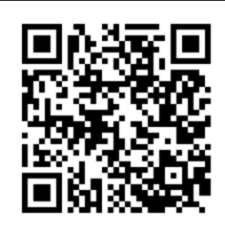
Let us know!
Please take the time to complete this short survey, in relation to the content of today’s module.
Please do report any urgent concerns / attendance issues directly to plp@csacentre.org.uk
Thank you for your participation!
Notes:
COPY INTO CHAT IF UNABLE TO USE QR CODE: Practice Leads Programme (PLP) Participant Sessional Survey: https://www.surveymonkey.com/r/PLPParticipantsurvey
FACILITATORS! Don’t forget your survey too: Practice Leads Programme (PLP) Facilitator Sessional Survey: https://www.surveymonkey.com/r/PLPFacilitatorsurvey

