Slide 1
Adult males who sexually abuse – child sexual abuse in the family context
Session four

Slide 2
What we will cover today
Setting the scene
Pathways to offending
How sexual abuse happens in families
Understanding assessment
What do we know

Slide 3

Why is this important?
Previous reviews, inquiries and investigations highlight a lack of focus on those who offend – in both assessments and interventions
Without a focus on the people causing the harm we miss a key piece of the puzzle
Spotting the signs of abusive behaviour is a more preventative approach than spotting the signs in children when they are already being abused
If we don’t understand grooming behaviours, we may unintentionally exacerbate abusive power dynamics

Slide 4
A whole family approach
Person of concern
Non-abusing parent
Children
Family network
Community network
Professional network
Notes:
Assessment or intervention in cases of intra-familial CSA needs to take account of all family members.
Intra-familial CSA does not happen in a vacuum – NEED the WHOLE FAMILY CONTEXT (statutory guidance advises this approach)
Already an approach in use for NEGLECT
WHY?
Risk Assessment – Must consider all family members
Risk changes over time
Consider what is happening in the family to stop children from telling
Examples
1. Alleged abuser high risk – Non-Abusing parent/s protective, robust and have minimal vulnerabilities and recognise the risks – Children are confident and have a strong relationship with non abusing parent – Consequently the risks may be manageable in this scenario
2. Alleged abuser relatively low risk of harm – BUT Non-abusing parent has multiple vulnerabilities, cannot recognize the risks and struggles to keep children safe - Child/ren also have vulnerabilities, poor relationship with their non-abusing parent. – Consequently, the risks may be much harder to manage.
What is happening in the family to stop children from telling?
In order to reduce risk, we need to think about all family members –
What are the vulnerabilities of the non-abusing parent/carer;
What are the vulnerabilities of the child; and
How has the alleged offender manipulated these in order to abuse the child – ******Remember professionals and communities can be groomed and manipulated!

Slide 5
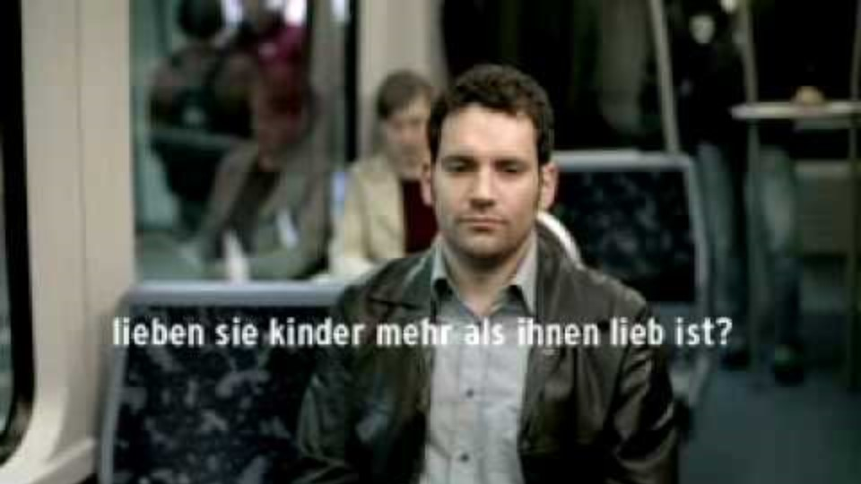
Notes:
lieben sie kinder mehr, als ihnen lieb ist? Means Do they love children more than they love themselves?
This is from the Dunkelfeld project – it is played on TV in Germany.
Trainer Note -
Read here for information about the Dunkelfeld Project.
https://www.theguardian.com/society/2015/oct/16/how-germany-treats-paedophiles-before-they-offend

Slide 6

Reflective discussion
What thoughts and feelings do you have when you think about people who have committed sexual offences against children?
Notes:
15 mins – groups of 4
Discussion - Working with people who have Committed Sexual Offences.
An opportunity for people to talk about how they feel about this area of work and how this may affect their practice (in small groups and feedback key points)
For large group discussion:
Encourage discussion in large group, could include:
Natural to feel aversion
Hard to work empathically with people who harm when you are also working with the people who they harmed
People are more than one part of their behaviour – first and foremost they are human beings.
Even those with sexual offences can and do change behaviour – harder when they are ‘paedophilic’ – explain difference between a paedophile and a ‘sex offender’
There is a difference between the terms paedophile and ‘sex offender’ – the ICD-10 and DSM-V have slightly different definitions for diagnosis. In the US they tend to refer to anyone who has sex with someone under 18 ‘a paedophile’ and in the UK the media often reports anyone who has sex with someone under 16 as a ‘pedo’. However, paedophile actually means someone who has an exclusive (or main) sexual interest in pre-pubescent children, while the term ‘hebophile’ relates to those with a sexual interest in post-pubescent children.
In this sense, a paedophile is not necessarily a ‘sex offender’ as they may not have acted on their fantasies. On the flip side a ‘sex offender’ is someone who has offended sexually against children, but whose motivation may or may not have been paedophilic interest, even if they abused a pre-pubescent child.
*A note on language
This is also an opportunity to discuss how people feel about the label ‘sex offender’
We have moved away from labeling people as their behavior in other fields – for example, we don’t say ‘alcoholic’, but someone who abuses alcohol, or has problematic alcohol use; we don’t say ‘schizophrenic’, rather someone with schizophrenia etc. We accept this in these other circumstances as we recognize:
The impact of labeling on people’s views of themselves (we want them to move away from seeing themselves just as an ‘alcoholic’, but someone who has a whole host of other qualities and characteristics, with one part of their behavior being alcoholism.
That people are more likely to move forward if they believe they can change – this is supported by changing the narrative
That if we call them by their negative behavior we portray that we believe they can never change, they will always be this person.
We have moved also moved away from this when we think about children and young people who have sexually harmed others – we no longer see them as ‘sex offenders in the making’, but young people who can change. We haven’t yet managed to do this with adults who have sexually abused.
As professionals working with people – we tend to hold a belief that the people we work with can change – that’s what gets us up in the morning, helps us do our work. However when it comes to those who have sexually offended, we tend to hold a strong belief that they can never change. Yet, interestingly, reconviction rates for those who have sexually offended are lower than any other crime.
You will find that people may respond with comments such as – but we don’t know about most abuse, so we don’t know that they don’t reoffend. While this is an important point, we may also want to consider that prison or other intervention may be effective for some.
Finally, labeling someone as ‘sex offender’ further feeds in to our tendency to see them as someone ‘other’, someone monstrous – and as we have seen in our previous slide, this is unhelpful for feeding into the narrative that we can ‘tell by looking’.
So, it would be useful for you to try, wherever possible, to use the term ‘people who have sexually abused’ – although we recognize this doesn’t necessary come easily.
For further reading see Gwenda Willis’ summary of her paper in NOTA New (article to be provided)

Slide 7

Notes:
A further video from Dunkelfeld project:
There is a line about paedophilia being a sexual preference in this video – this feels controversial because:
Homosexuality is a sexual preference, but this is legal (when over the age of consent), and if we start to look at paedophilia as a sexual preference, then is there a danger that people start to argue that this too should be legal? There are networks of paedophiles who have used this to justify their behavior – i.e. if it is a sexual preference, it must be natural; and, we used to judge homosexuality as unnatural, but now view it is natural – we are just slower to do this with paedophilia.
Does calling it a preference risk excusing the behavior? The advert is clear that they are different things, but again some people, in particular survivors of sexual abuse, find this reference offensive.
However, there is some evidence/theory that there are differences in the brain/brain development between ‘true paedophiles’ and non-paedophiles –Dr K Beier who works on the project, being one doctor who argues this.
If none of the participants raise these points, it is important to do so.

Slide 8
“Each of us is more than the worst thing we’ve ever done”
(Stevenson 2014)
Notes:
This is a quote by Bryan Stevenson, a public interest lawyer. It is taken from a Ted talk called ‘we need to talk about injustice’. During the talk Bryan spoke about identity, and how the identity we hold of ourselves and the identity assigned to us by others has tremendous power in what we believe we can do and how we are treated by others.

Slide 9
What do we know?

Slide 10
Men who sexually offend
What we currently know
Who they abuse
Risk taking
Arousal
Type of abuse
Preoccupation
Notes:
This slide specifically refers to adult males who have sexually offended against children and whilst there are some similarities, there are also many differences
Some have abused one child and some many.
Some have a pattern of abusing a child as a ‘one-off’ and then move on.
Others abuse the same child over a long period of time.
Some do both.
Some are risk takers, most are not.
Patterns of arousal vary: only to children, to one child, to adults and to child/ren, sadistic arousal.
There are different styles of abusing: seductive/angry/sadistic.
Some people think about offending all the time, but many do not.
Some drift in and out of offending at different times of life.
There are also differences in offending patterns -
Some offenders:
Only ever abuse one child / some only one child in a family / some all the children in a family – Click Click
Pattern of abusing a child as a ‘one-off’ and then move on –May have an arousal to a particular sexual act – do it & move to the next child
Others abuse the same child over a long period of time – A parent in a family may abuse a child over a period of many years – 4-18 yrs old
Some are Risk Takers, most are not – reading victim statements can help work out if this is a risk-taker or not – for example, a man who abuses a child in the presence of other family members
Patterns of Arousal Vary: only to children, to one child, to adults and to child/ren.
There are different styles of offending: Dependent on mental script / Fantasy and Arousal - seductive/angry/sadistic –
How a child has been sexually abused twill make a difference to the impact on them, and how we work with them moving forward
Some think about offending all the time, but many do not – if someone thought about offending all of the time, they would probably need to be held in high security settings.
Some drift in and out of offending at different times of life – there will be times when someone poses more or less risk, depending on what is going on in their lives – This is why there are assessment tools for managing offenders such as Acute and Stable Assessment

Slide 11
“The most striking characteristic of sex offenders* is their apparent normality”
(Herman, 1990)
* A note on language
Notes:
An old quote, but a useful one. We just cannot tell by looking. I usually give an example here of a man I worked with who was well dressed, charming (but not overly so), presentable, intelligent – and I had to try hard to keep reminding myself that despite all this, he could still be an abuser, as the media portrayal is hard to shift.

Slide 12

Likelihood of reoffending
Recidivsm
Rehabilitation
Notes:
In England and Wales, for example, 7.5% of those released from prison between 2002 and 2012 had been convicted of another sexual offence by October 2015 (Mews et al, 2017). It should be noted, however, that most CSA does not come to the attention of the authorities.
In that study, the reconviction rate for offences of any sort over the same period was considerably higher at 38% (Mews et al, 2017).
A review of the international literature (Mann et al, 2010) concluded that the following factors were related to sexual reoffending (not specifically CSA offences):
‣ sexual preoccupation and sexual interests supporting offending
‣ offence-supportive attitudes ‣ emotional congruence with children (i.e. feeling more comfortable around children than adults, thinking of children as friends, and being emotionally attracted to children) and a lack of emotionally intimate relationships with adults
‣ lifestyle impulsivity, general self-regulation problems and poor cognitive problem-solving
‣ resistance to rules and supervision, grievance/ hostility and negative social influences
For those men whose motivation is exclusive sexual interest in children, i.e. paedophilia, how have offended, risk for reoffending is significantly higher.

Slide 13
Pathways into offending

Slide 14

Group discussion
Why is it important to understand why some adults sexually abuse children?
Notes:
Large group discussion – 10 mins

Slide 15
Why an individual shows sexually abusive behaviour
Understanding why is not excusing the behaviour and its implications for others.
It is important so that:
Professionals, those who harm, and non-abusing parent & carers can manage risk
To inform the type of intervention that may assist the victim
To inform the type of intervention that may assist the person who has harmed
To address the changeable factors (e.g. such as difficulty in emotional self-regulation, substance misuse, mental health) that can be addressed to reduce risk
Notes:
Acknowledge how strange it can feel trying to understand the perspective of an abuser and why they did it – it can feel in some way collusive – however unless we understand why, we won’t be able to stop abuse happening.
Important to look holistically at the situation – not just what is happening in the ‘now’ but also exploring events that happened in the past and how the these interact. Factors change and so therefore can risk.

Slide 16
Theoretical approaches
1984
Finkelhor’s four pre-conditions model
1990
Marshall & Barbaree’s integrated theory
1992
Hall & Hirschmann’s quadripartite model
2002
Ward & Seigert’s pathways model
2006
Ward & Beech’s integrated theory
2019
Seto’s motivation-facilitation model
Notes:
Just to show participants that these theories exist.
Each of these theoretic approaches takes a slightly different view about which of the previous factors is more or less relevant and they each suggest a different process.
A couple of key points to mention. Firstly, there is still a lot of the debate about how many of the factors lead specifically to sexual offending rather than other types of offending. Second is the role of context and opportunity. Two of these models (Finkelhor and Seto) discuss the opportunities to offend but none of the other models do this explicitly.

Slide 17
What do (or should!) theoretical approaches consider?
Developmental factors
Acute, dynamic factors
Context
Vulner-ability factors
Notes:
Before we look at some of the theoretical approaches to helping us understand why some adult males sexually abuse children, let’s think about what these approaches might involve – what sorts of things do the different theories talk about?
So what might that look like in reality?

Slide 18
For example…
Insecure
attachment
Need for
Intimacy
Access to a victim
Difficulties building relationships
Notes:
However, what this still doesn’t quite explain is why most people who don’t develop secure attachments and struggle to build relationships don’t sexually abuse children
So what other things do we need to think about when helping us understand

Slide 19
Summary
Early childhood / developmental experiences
Emotional regulation
Cognitive distortions
Deviant patterns of sexual arousal
Opportunities to offend
Notes:
There are a number of different theories to help us understand who someone might sexually abuse a child. Each focuses on something slightly different but broadly speaking there is some agreement that these things are important
Early childhood / developmental experiences
Attachment
Early experiences of abuse
Emotion regulation
How you make sense of and manage your emotions
Cognitive distortions
The scripts you develop to justify your actions to yourself
Deviant patterns of sexual arousal
Opportunities to offend
Move to next slides for two examples

Slide 20
What might this look like?
Insecure attachment
Adult rejections
Social isolation
Children seen as less hostile
Emotional congruence
Sexual offence
Notes:
This relates to intimacy deficits pathway.

Slide 21


What might this look like?
Sexual abuse as a child
Learning to manage emotions through sex
Children are sexual beings and enjoy sex
Masturbate to thoughts of children
Left alone with a child
Notes:
These are examples of the factors on the previous slide and demonstrate how they may interact and lead to a sexual offence
E.G
Early childhood / developmental experiences
Sexual abuse as a child
Emotion regulation
Learning to manage emotions through sex
Cognitive distortions
Children are sexual beings and enjoy sex
Deviant patterns of sexual arousal
Masturbate to thoughts of a child or children
Opportunities to offend
Left alone with a child

Slide 22

Thoughts and reflections
Notes:
Questions on what we have covered so far
Initial reflections?

Slide 23

Break

Slide 24
How sexual abuse happens in families

Slide 25
Building the picture
Step 1
Potential signs and indicators of sexual abuse and sexually abusive behaviour
Step 2
How might abuse have happened in this family?
Step 3
Considerations for assessment
What do you need to ask, of who?
Which sources of information?
Timeline of family events
Step 4
What interventions do we need to reduce the risk?
With each member of the family
With each relationship within the family
Finkelhor Pre-conditions model
Notes:
Introducing a possible framework for assessing concerns of sexual abuse.
In sessions 1 and 2 we thought about the signs and indicators of sexual abuse.
Today we are going to focus on steps 2 and 3 of this framework.

Slide 26



Task 1 - Thought to Action
I want you to all think of something you do, that you enjoy doing but probably isn’t that good for you – e.g., smoking, drinking, over-eating, drug-taking, speeding in your car, over-surfing the internet.
In the first column of your worksheet, write down all the reasons why you do this thing.
Notes:
Thought to Action.
Trainer Note - This is a group exercise where the participants are asked to think about how they get from thinking about something to doing it – it is an experiential exercise which will lead to the introduction of Finkelhor’s 4 Pre-conditions Model (Covered in the following Slides).
participants are to use the handout ‘Tasksheet 1’ to document their thoughts and responses.
Trainer - Read instructions from the slide.
Slowly uncover each section of the Slide and then allow the participants time to complete the task.
Once they are done - Move onto the next slide.

Slide 27
Task 1 - Thought to Action
You’ve decided to give up this thing you do, and you’ve been doing really well not doing it. BUT you really, really want to do this thing.
In the second column of your worksheet, write down all the things you may tell yourself to allow yourself to do it.
Notes:
Thought to Action.
Trainer Note - This is a group exercise where the participants are asked to think about how they get from thinking about something to doing it – it is an experiential exercise which will lead to the introduction of Finkelhor’s 4 Pre-conditions Model (Covered in the following Slides).
participants are to use the handout to document their thoughts and responses.
Trainer - Read instructions from the slide.
Slowly uncover each section of the Slide and then allow the participants time to complete the task.
Once they are done - Move onto the next slide.

Slide 28
Task 1 - Thought to Action
So, you’ve persuaded yourself you are going to do this thing, but everyone in your life is really invested in you not doing it, they are proud of you for not doing it.
In the third column of your worksheet, write down how you manage to get past them in order to do this thing.
Notes:
Thought to Action.
Trainer Note - This is a group exercise where the participants are asked to think about how they get from thinking about something to doing it – it is an experiential exercise which will lead to the introduction of Finkelhor’s 4 Pre-conditions Model (Covered in the following Slides).
participants are to use the handout to document their thoughts and responses.
Trainer - Read instructions from the slide.
Slowly uncover each section of the Slide and then allow the participants time to complete the task.
Once they are done - Move onto the next slide.

Slide 29
How your worksheets may look…
Why do I do it? | How do I persuade myself to do it? | How do I get past others?
Boredom Feeling down Tiredness To relax To calm down I enjoy it Loneliness Excitement Rebellion Control Comfort Stress relief
Notes:
Column 1.
Talk through the sorts of things that may have been on people’s worksheets – or depending on time ask them what they wrote down

Slide 30
How your worksheets may look…
Why do I do it? | How do I persuade myself to do it? | How do I get past others?
Boredom Feeling down Tiredness To relax To calm down I enjoy it Loneliness Excitement Rebellion Control Comfort Stress relief | Just this once No one will know I deserve it …I’ve had a hard day …I’ve had a good day It’s my life… It’s my right Will stop again tomorrow There are worse things Other people do it I’ve been so good in other ways
Notes:
Column 2.
Talk through the sorts of things that may have been on people’s worksheets or if time, what they have written down
Move to next slide.

Slide 31
How your worksheets may look…
Why do I do it? | How do I persuade myself to do it? | How do I get past others?
Boredom Feeling down Tiredness To relax To calm down I enjoy it Loneliness Excitement Rebellion Control Comfort Stress relief | Just this once No one will know I deserve it …I’ve had a hard day …I’ve had a good day It’s my life… It’s my right Will stop again tomorrow There are worse things Other people do it I’ve been so good in other ways | Do it when they’re not there Lie Deny Minimise Justify Distract Hide the evidence Blame others
Notes:
Column 3.
Talk through the sorts of things that may have been on people’s worksheets, or if time, what they have written down
Move to next slide to show them the model.

Slide 32




Finkelhor’s Precondition Model (1984)
Action / abuse
Thought / intent
Motivation
‘Want to do’
Internal Inhibitors
‘Conscience’
‘Consequences’
External Inhibitors
‘Others’
‘Create Opportunity’
Overcome Victim Resistance
‘Gain compliance’
‘Prevent disclosure’
Notes:
32
32
Having undertaken the above exercise you can discuss how this applies to the 4 stages of this model.
It is an opportunity to get participants thinking about what factors may make it easier or harder to overcome internal inhibitors, external barriers and the victim.
Note the following points:
This model was created with adult male ‘contact’ offenders in mind.
it is not a model that was created in relation to internet offenders, young people, or female offenders.
It can however be used with internet offenders (in particular the first three stages); to support assessment and intervention with some young people; and there are one or two examples in research of it being applied to females, but we will focus on adult males today.
The hurdles get smaller after each jump – essentially the hardest thing to overcome is your own internal inhibitors, hence that being the highest hurdle.
Some suggested questions/areas to explore:
Don’t Abuse
There will be some people who at one time or another feel sexually attracted to a child or a young person, but who know that to act on it is illegal, immoral and wrong – so they don’t act on it. They never persuade themselves that it is ok for them to abuse a child.
Do Abuse
1. Internal Inhibitors
However, there are some who do manage to persuade themselves it’s ok –
What might they tell themselves to make it ok?
Compare across to participants’ answers from last exercise
What might be going on in their lives that makes it harder/easier to resist acting on their thoughts?
E.g. drugs/alcohol/stress/mental health
Compare across to participants’ answers from last exercise
If overcome their internal inhibitors NEXT
2. External Inhibitor - Protective People around Child
Overcome the protective people around the child –
Protective Parent has a strong relationship with their child, is robust, has limited vulnerabilities – Not overcome by abuser
Q2C - What factors may make it easier for the abuser to overcome the non-abusing parent/carer ?
Encourage participants to name all possible vulnerabilities – mental health, learning disability, physical disability, substance/alcohol misuse, low self esteem/dependency; domestic abuse; etc. We will be going into more detail on this in the next session (4).
Compare across to participants’ answers from last exercise
Generally abusers need to interrupt the relationship between the non-abusing parent and the child in order to abuse the child.
For some, there was never a good relationship – e.g. post natal depression which affected attachment, lack of attunement, never very close, so it is not so difficult to interrupt this relationship.
For others there needs to be an active interruption of the relationship –
What ways may an abuser actively interrupt the relationship?
Putting the mother down by telling the child she is stupid / Physical / Verbal abuse
Telling the mother that the child doesn’t love her
Making the mother and child ‘love rivals’ – use example
3. Overcome the Child
Some children will be too difficult/risky to overcome because they are robust, have strong relationships with family and friends, lack of vulnerabilities.
Some children’s vulnerabilities can be targeted by abusers –
Q2C - What may these vulnerabilities be?
encourage participants to name all possible vulnerabilities –low self esteem, no friends, isolated, personal issues etc.
Sadly - The higher the need in the child, the easier it is for abusers to groom the child by meeting those needs – i.e. a child who is neglected within their family will crave attention.
NOTE: Abusers who have worked with professionals after conviction and indicated that they can target a child just by watching them in a community
Return to the point that this does not excuse behaviors but serves to highlight that by understanding how someone ends up committing an offence helps us understand how offences can be prevented

Slide 33

Task 2 - Case study
Notes:
Task 2: Group to read the case study and fill out task sheet 2 in relation to Simon’s father
Everyone will have been sent the case study which includes a part 1 and part 2. They have already seen part one in the previous session when they did the signs and indicators exercise, so this is a reminder. Task sheet 2, which they need to complete, has the four columns one with motivation, overcoming internal inhibitors etc.
As you go through next few slides you can gather feedback from the groups.

Slide 34
Motivational factors
Finkelhor suggests there are three possible motivational factors underlying the sexual abuse of children
  Emotional congruence
  Sexual arousal
  The fact that some individuals are blocked from meeting their emotional and sexual needs in prosocial ways
How might these relate to Simon’s father?
Notes:
Emotional congruence involves a fit between an adult’s emotional needs and the characteristics of a child. For example, the need to feel powerful and in control or the identification with young children due to the adults own emotional or cognitive development.

Slide 35
Overcoming internal inhibitors
An abusive act will not simply occur because a person is motivated to sexually abuse. Internal inhibitors need to be overcome.
The emphasis here is on factors that disinhibit behaviour.
For example, these might be the use of alcohol or drugs or the development of cognitive distortions to validate behaviour
How did Simon’s father overcome his internal inhibitors?
Notes:
35
35
An internal inhibiter can be thought of as some thing within the individual that prevents a behaviour
Thinking back to you own example we can overcome out internal inhibitors by making excuses for behaviour, justifying it for some reason or another. I know I shouldn’t have a chocolate bar because I'm on a diet but maybe I can because I’ve had a stressful morning and deserve it.

Slide 36
Overcoming external inhibitors
Motivation and overcoming internal inhibitors are not enough for sexual abuse to happen, the adult needs to create the opportunity to abuse.
Reduced supervision of children, absence or illness of the other parent or carer, unusual opportunities to be alone with a child are all correlated with child sexual abuse.
Grooming the non-abusing parent is also part of the process of overcoming this external inhibitor.
How did Simon’s father get past his mother to abuse Simon?
Notes:
36
36
Where internal inhibitors are related to intrapersonal factors, external inhibitors relate to situational and environmental factors.

Slide 37
Overcoming victim resistance
When the first three preconditions are met, abuse may not occur as the individual is unable to produce compliance in the child.
Emotional insecurity, deprivation, lack of sexual knowledge and situations of unusual trust/power between a child and the person who wants to harm them are all factors that can reduce resistance.
“Many, perhaps most, incidents of sexual abuse of a child involve specific actions and words in which an older person uses superior skill, knowledge or resources to gain and maintain sexual access to the child.” (Conte 1991).
How did Simon’s father overcome Simon?

Slide 38
Assessments
An introduction

Slide 39

Group discussion
Keeping in mind everything we have discussed today, what areas of the person of concern’s life do we need to find out more about to help us assess risk?

Slide 40
What might you consider in your assessment?
History of offending, including sexual
Relationship history (intimacy deficits – emotional or sexual)
Emotional self-regulation/ management (mental health, substance misuse, anger, stress)
Sexual self-regulation/ management (e.g. sexual preoccupation)
Congruence with children (for males)
History of childhood trauma, abuse, attachment difficulties
Issues of power and control (e.g. violence/aggression)
Sexual interest in children
Distorted scripts/views of sex and children (gender, sexual entitlement)
Social isolation/difficulties in social relationships
Previous intervention or treatment
What’s changed? (in relation to historical allegations)

Slide 41

The importance of context
If this happened, how might it have happened?
What is your hypothesis?
When is it reported to have happened?
What times of day is it reported to happen?
Does it fit with any changes in family dynamics?
Does it fit with any major events/incidents in the family?
Has there been relationship breakdown?

Slide 42
The timeline
On a piece of paper (large is good) plot with the non-abusing parent (and/or person of concern) any major events since they met their partner.
This could include – births, deaths, marriages, affairs, miscarriages, job gains and losses, mental health episodes, substance or alcohol misuse episodes and so on.
Notes:
Use Zoom whiteboard if possible to demonstrate this live…

Slide 43
The timeline
Then plot by way of a curvy line how their relationship was over time (including sexual activity)
Notes:
Use Zoom whiteboard if possible to demonstrate this live…

Slide 44
The timeline
Then plot when there were concerns about the child (in a different colour pen) – changes in behaviour or mood, reports of harm etc.
This is useful for our assessment, but also sows the seed for the non-abusing parent to think about how they and their child/ren may have been groomed and their child/ren abused.
Notes:
Use Zoom whiteboard if possible to demonstrate this live…

Slide 45
Considerations for assessment
Family dynamics – how does the person of concern behave…
Behaviour towards child/ren
Behaviour to non-abusing partner
Evidence of ‘grooming behaviour’ - Favouring, spoiling, buying treats, punishing, singling out, scapegoating, putting down, blaming, controlling, resenting
Play fighting, tickling
Dominating care of child
How did they meet?
Control/power – explicit or implicit
Violent/aggressive/undermining/dismissive/idolising
Being ‘invaluable’, ‘great with the children’, helpful,
Behaving like one of the children “it’s like having another child”
Notes:
Considerations for Assessment - Family Dynamics - How does the person of concern behave…
As above.

Slide 46
Sources of information
Interviews (individually and together)
Observations
Case chronology
Previous files
Information from Police and Probation (including victim statements)
Information from education & health
Theory and research

Slide 47
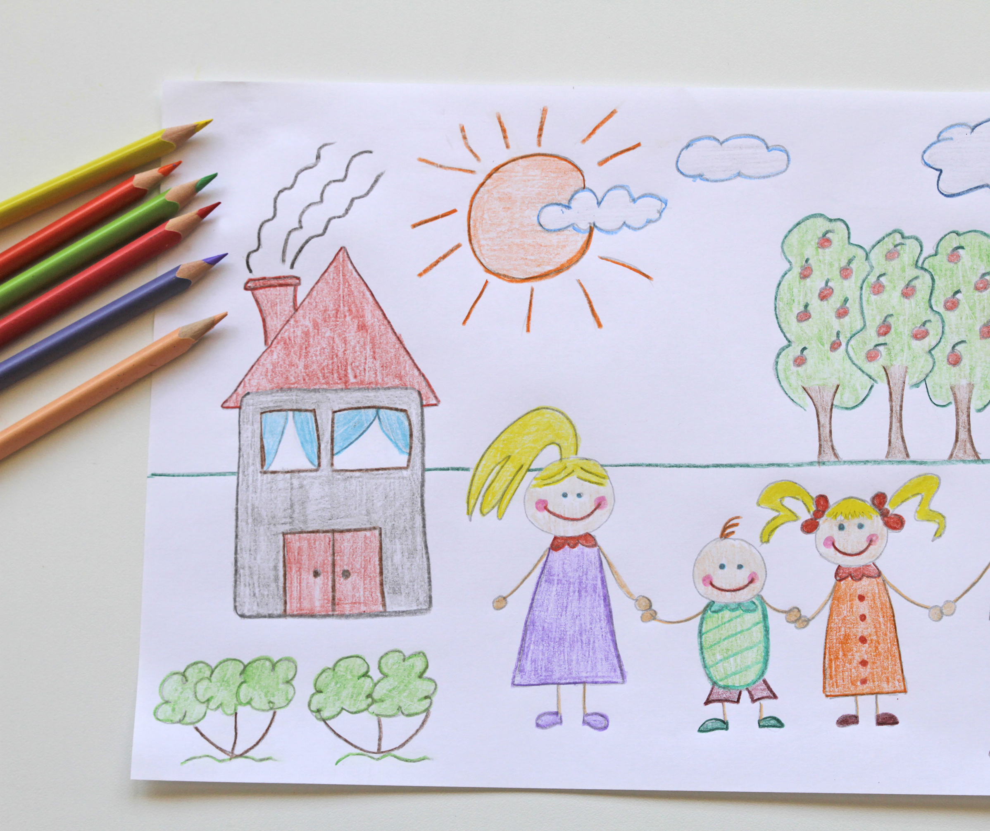
Ensuring plans and interventions are effective
Given what you have learned about adult offender behaviour, the context in which it takes places and motivations do you think multi-agency child in need and child protection plans take sufficient account of these issues?
Do we provide situational opportunities unintentionally?
Notes:
Ask the group to think about these questions specifically
Do plans (in whatever context) put adult offenders in situations where they can wield power?
What about attendance at meetings - what do they say to the victim about this?
What tasks are they given to do – like providing financially, taking children to school, decorating the house?
Do we provide situational opportunities unintentionally?
Do we help adult offenders overcome external barriers unintentionally?
Do we help adult offenders gain access to children unintentionally?
Do you have your own examples?

Slide 48
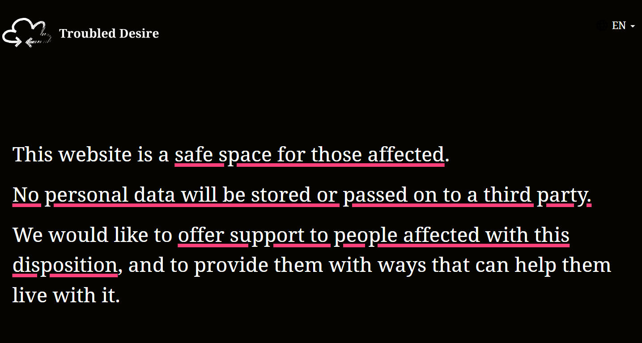
Troubled desire – an example of online resource
https://troubled-desire.com/en/ - includes online self management programme
Notes:
To show group as an example of resources available for those who are worried about their thoughts about children.
Trainer Note - See the website for more info
https://troubled-desire.com/en/ - includes online self management programme

Slide 49

Stop It Now! helpline
If you are worried about your own thoughts or behaviours or are worried about the behaviours of someone around you, you can contact the Stop It Now! helpline for free, confidential advice:
0808 1000 900

Slide 50

Find a support service
Being able to access support, as a child, young person or adult, is crucial to mitigating the impacts of child sexual abuse.
To help make this easier, the CSA Centre has created a directory containing over 350 child sexual abuse support services in England and Wales.
The accessible, searchable Support Services Directory is a simple way for victims and survivors, their families, or professionals, to find services that can help.
Find support services and get help today.
csacentre.org.uk/get-support/
Notes:
People can search by location, or by clicking on a region on the map. It contains support services for all those who may be impacted by child sexual abuse, including children and young people, parents and carers, and adult victims and survivors of child sexual abuse.
It is completely confidential to access - no sign-up is required, and no information is saved when people search for support.
Those seeking help can also find local and national services offering focused support for women and girls, men and boys, LGBTQ+ people, disabled people and for people specifically from ethnic minority backgrounds.
It’s a particularly valuable tool for professionals working with those affected by childhood sexual abuse to quickly find and recommend support for the children and adults they work with.
Sadly, as evidenced in the CSA Centre’s Support Matters report, there remains a shortage of support services for those who have experienced child sexual abuse.
Whilst getting support can play a large role in victims and survivors feeling able to move forward from sexual abuse in childhood, children and adults are still waiting too long to receive help.
In addressing this, the new support services directory can also be used, alongside our Data Insights Hub, to better understand the support landscape in England and Wales, for commissioners of services and those seeking change.

Slide 51
Thank you!
For more information please contact:
info@csacentre.org.uk

Slide 52
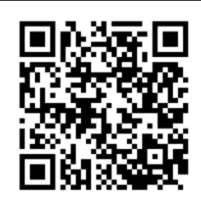
Let us know!
Please take the time to complete this short survey, in relation to the content of today’s module.
Please do report any urgent concerns / attendance issues directly to plp@csacentre.org.uk
Thank you for your participation!
Notes:
COPY INTO CHAT IF UNABLE TO USE QR CODE: Practice Leads Programme (PLP) Participant Sessional Survey: https://www.surveymonkey.com/r/PLPParticipantsurvey
FACILITATORS! Don’t forget your survey too: Practice Leads Programme (PLP) Facilitator Sessional Survey: https://www.surveymonkey.com/r/PLPFacilitatorsurvey

