Slide 1
Introduction to the CSA Centre Practice Leads’ Programme
Notes:
Lesson Title Slide.

Slide 2

Thank you for being here
Notes:
We know that we are all facing a number of pressures and competing priorities at the moment despite all the pressures you are still here - so already you are working to tackle sexual abuse. We really appreciate you being here and being committed to the Practice Leads programme over the coming year.
We want to be able to share a hopeful message today and to demonstrate that, by all working together, we can tackle child sexual abuse

Slide 3
Looking after yourself and others
Sexual abuse can be difficult to think about and talk about. Thinking about it and talking about it will affect us all in different ways, at different times.
It is important that we…
Be aware of the feelings and experiences of other delegates
Be kind to ourselves (personally and professionally)
Respect each other’s learning journey
Notes:
We know a lot of people have experienced sexual abuse, so be aware of the experiences that may be in the room.
Be kind to ourselves (personally and professionally)
If we need a break from the material, then we can do this by leaving the session
If we decide we can’t do this today, that’s okay
Respect each other’s learning journey
There is no such thing as a stupid question – this is
the space to ask, clarify, discuss and get things wrong
There will be a couple of interactive exercises, so please do contribute to discussion – be brave!

Slide 4
What we will cover today
Introduction to the Centre of Expertise (The CSA Centre)
Embedding the Programme
An overview of the Practice Leads Programme
Hearing from the Practice Leads
The principles and challenges in practice
Impact of this work and self-care

Slide 5
Introduction to the Centre of expertise on child sexual abuse (The CSA Centre)
Notes:
Introduce yourself to the group, give a background of you professionally and also, what you deliver training on for the CSA Centre

Slide 6

The CSA Centre
  We are the Centre of expertise on child sexual abuse (CSA Centre). We want children to be able to live free from the threat and harm of sexual abuse.
  Our aim is to reduce the impact of child sexual abuse through improved prevention and better response.
  We are a multi-disciplinary team that works closely with key partners from academic institutions, local authorities, health, education, police and the voluntary sector.
Notes:
The Centre of expertise on child sexual abuse was established in 2017 in the wake of the public and policy recognition of child sexual abuse, with one of its priority tasks to improve the evidence base on the scale and nature of child sexual abuse and use that evidence based to inform policy and practice.
We are a multi-disciplinary team, we are funded by the Home Office, hosted by Barnardo’s and we work closely with key partners from academic institutions, local authorities, health, education, police and the voluntary sector. However, we are independent of both and set our own research, practice and training agenda.
We want children to be able to live free from the threat and harm of sexual abuse and our aim is to reduce the impact of child sexual abuse through improved prevention and better response. We recognise that to tackle child sexual abuse we must understand its causes, scope, scale and impact. We know a lot about child sexual abuse and have made progress in dealing with it, but there are still many gaps in our knowledge and understanding which limit how effectively we are tackling the issue. We bring about change by:
- Collating and analysing existing research, policy, practice and the real experiences of those affected, and filling the gaps we identify with new research, insights and analysis.
- Using that evidence and insight to develop new approaches and apply learning in practice through the resources we provide and the training we deliver.
We operate across England and Wales

Slide 7
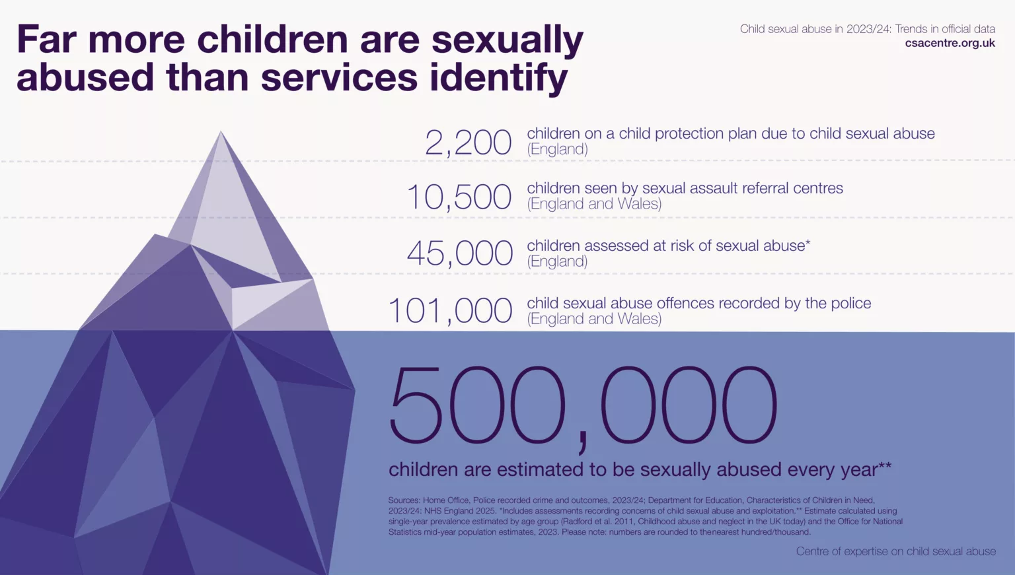
Notes:
Our scale and nature strand of work is one of our key functions at the CSA Centre with trends in data being published yearly.
There continues to be a drastic gap between the estimates of prevalence and the number of children identified in official data. The top-level changes in the latest year compared to the previous year, were minimal, although changes did occur underneath the overall figures.
It remains the case that while survey data suggest around 500,000 children would be sexually abused in England and Wales every year, a far smaller numbers are seen in agency data. (Read though the overall figures).

Slide 8


Understanding the scale and nature of child sexual abuse in England and Wales
Full review of latest prevalence data
Annual analysis of latest trends in official service data
Notes:
Every year we publish data on the scale and nature of child sexual abuse.
The review of evidence summarises all types of sexual abuse data in England and Wales – the survey data, the agency data.
The annual trends report summarises just the agency data trends.
We have long been calling for a national prevalence survey, so we can establish whether there are changes over time in the numbers of children being sexually abused in different contexts.

Slide 9

The Data Insights Hub
Local and national data on child sexual abuse in England & Wales
The Data Insights Hub is our new interactive online dashboard designed to enable professionals, commissioners and researchers to find, understand and use official data on child sexual abuse.
Using interactive maps and charts, the Data Insights Hub displays official data from local authorities and police forces, alongside up-to-date estimates on the scale of child sexual abuse, all in one place.
csacentre.org.uk/data-insights-hub/
Notes:
As well as providing insights into the prevalence and identification of child sexual abuse, it includes information on the number of local support services available for children who have been abused and their families.
By providing more ways to interrogate and understand local practice in the identification of and response to child sexual abuse, the Data Insights Hub can empower you to not just to ask better questions about child sexual abuse but, also, inform future decision making with the children and families you might work with.
Exercise: 5 mins: Individually, go to the data insights hub and find your local social care (CIN assessments, CP plans, local iceberg, number of support services) and police data.

Slide 10
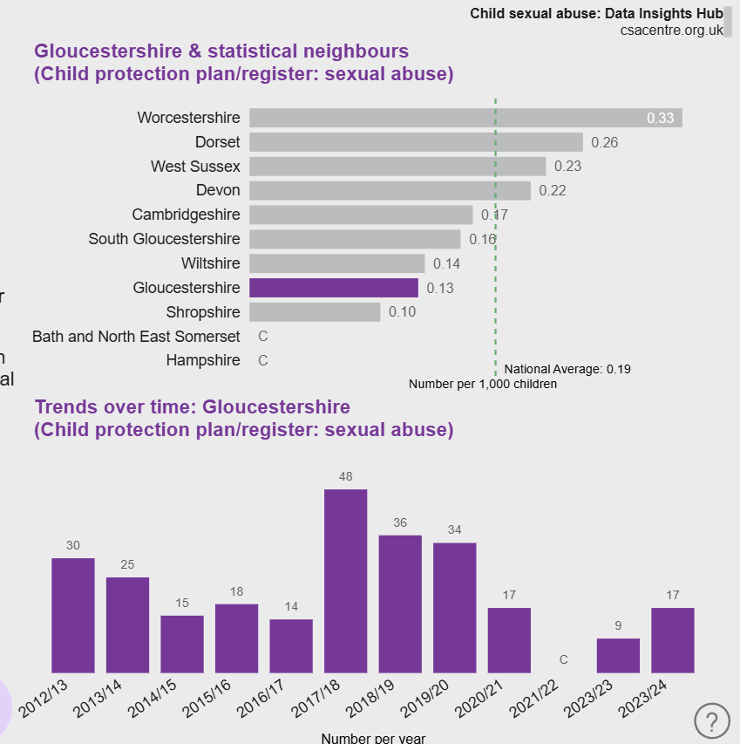
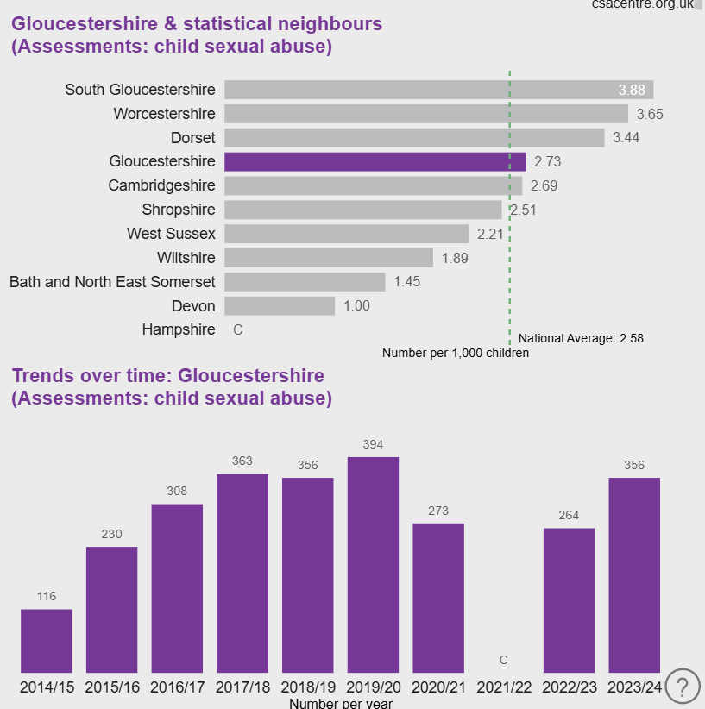
The Data Insights Hub
Local and national data on child sexual abuse in England & Wales
Notes:
ENSURE THE LOCAL DATA IS COPIED AND PASTED HERE, FROM THE LOCAL AUTHORITY YOU ARE DELIVERING TO – THIS CAN BE DONE ON THE DATA INSIGHTS HUB FOUND HERE - https://www.csacentre.org.uk/data-insights-hub/
If this is a national programme, remove this slide

Slide 11

Working with people with lived experience
  We work with experts by experience in the following ways:
  Our Advisory Board includes experts by experience who represent organisations who support victims and survivors
  Experts by Experience consult, advise, review, support and train with us
  Audio and visual resources by victims and survivors are included in training
Notes:
Alongside our multi-disciplinary approach to the work, we also work with people with lived experience of child sexual abuse.

Slide 12
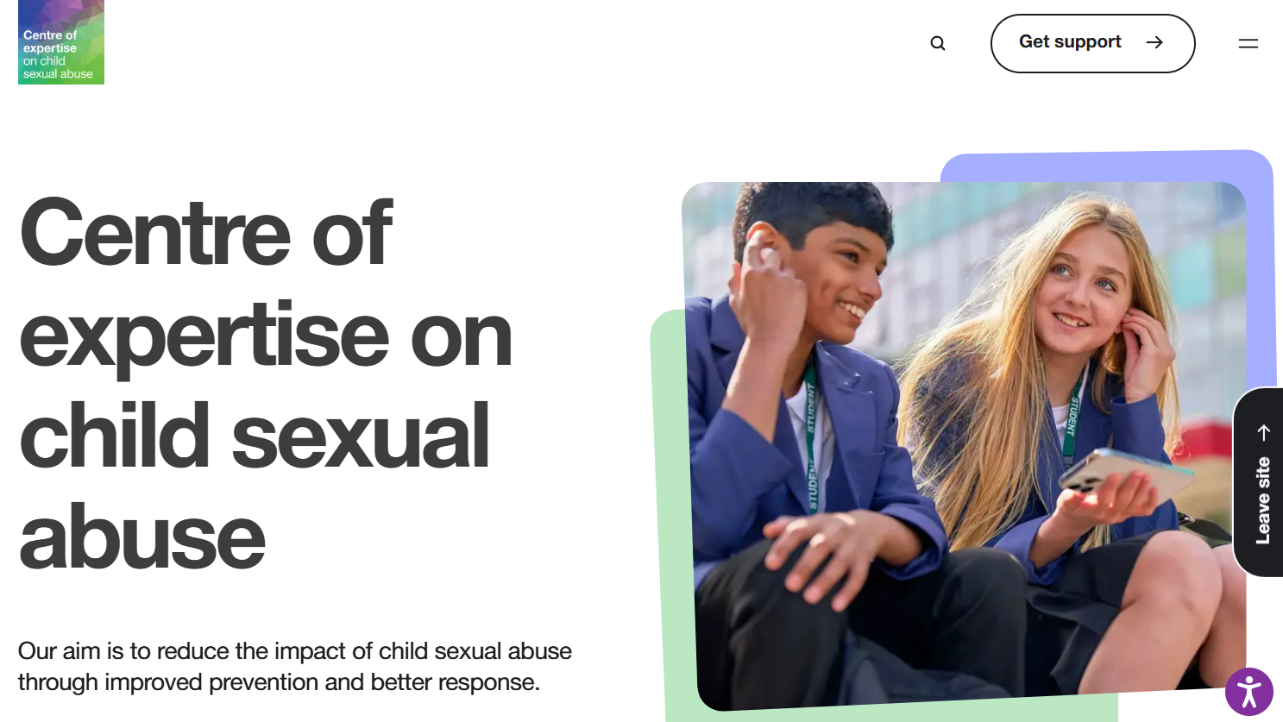
Notes:
I’d like to introduce you to our website that is full of free to use resources and key messages from research, that we will explore throughout the programme.
Before the next session, please take time to have a look around this, sign up to the newsletter, find a piece of research and search for your local authority data and come back with any questions you have. We will show you how to do this, over the coming few slides.

Slide 13

The Child Sexual Abuse Response Pathway
An interactive online resource to guide professionals through how they can protect and support children and their families when there are concerns of sexual abuse.
The Response Pathway sets out how to respond to concerns of child sexual abuse at key points: from first concerns and early help safeguarding through to child protection and criminal justice. Throughout, the Response Pathway focuses on meeting the needs of children and their families.
It is designed to empower professionals to understand the role they, and their colleagues, can play to best protect and support children. It doesn’t just tell professionals what to do, it helps them to understand how to do it.
http://www.csacentre.org.uk/response-pathway
Notes:
Big holistic response to child sexual abuse, a more systemic response.
Hear consistently that the child protection pathway is well understood, but lack the specifics around child sexual abuse in particular.
Set out detailed guidance at key points – what are the specific considerations here in relation to child sexual abuse? Keep bringing it back to children, how will the child be feeling?
Key focus for us in all our work – not just telling people want to do, but helping them understand how to do it.
The National Panel report has recommended that partnerships take a ‘pathway approach’ to working with child sexual abuse. The pathway is now embedded in Safeguardign procedures in London, Greater Manchester and the West Midlands.
BEFORE THE NEXT SESSION: Ask participants to have a look at the response pathway ahead of the next session.

Slide 14



Resources to support practice
A template for professionals to identify and record concerns of child sexual abuse
A guide for professionals working with children who have or may have been sexually abused
A guide for professionals working with families affected by child sexual abuse
https://www.csacentre.org.uk/research-resources/practice-resources/film-series/
Notes:
Trainers note:
This is a quick tour of the practice resources, which will be returned to throughout the programme.
Signs and indicators (Dec 2021)
A template for identifying and recording concerns of child sexual abuse
Communicating with children (Feb 2022)
A guide to working with children who have or may have been sexually abused
Supporting parents and carers (Mar 2022)
A guide for professionals working with sexually abused children
Note link to short films of the resources on this slide

Slide 15

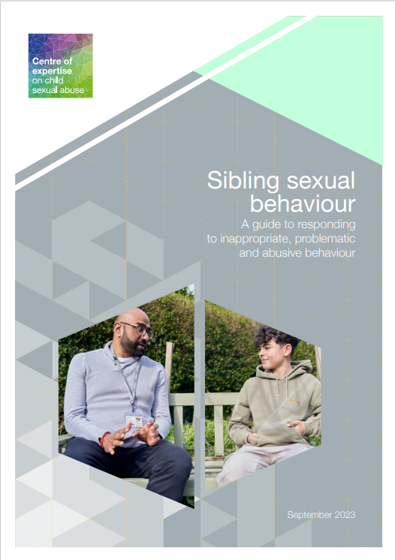

Resources to support practice
A guide for professionals supporting children following incidents of harmful sexual behaviour
A guide to responding to inappropriate, problematic and abusive behaviour
A guide to help professionals safeguard the whole family when a parent has accessed child sexual abuse material
https://www.csacentre.org.uk/research-resources/practice-resources/

Slide 16

Resource to support practice
Our Using supervision and team meetings to improve responses to child sexual abuse guide helps professionals start discussions about child sexual abuse within their teams, reflect on the experiences of children and families they are working with, explore their team’s and their own welfare, and consider how the evidence might inform and develop their practice.
Free to download:
http://www.csacentre.org.uk/knowledge-in-practice/practice-improvement/
Notes:
Professionals working with children and families play a key role in protecting and supporting them when there are concerns about child sexual abuse.
One way to build professional confidence in responding to concerns is by encouraging conversations around the latest research and evidence. Managers and supervisors can actively support this by making time for regular discussions, reflecting on and sharing practice experiences and insights from victims and survivors in supervision and team meetings.
Our Using supervision and team meetings to improve responses to child sexual abuse guide helps professionals start discussions about child sexual abuse within their teams in a supportive space, reflect on the experiences of children and families they are working with, explore their team’s and their own welfare, and consider how the evidence might inform and develop their practice.
It helps managers and supervisors support professionals at all stages of their careers across the children’s services workforce, including those in child protection, working with children with disabilities, children in care, adult social care, youth offending or early help.
Using supervision and team meetings | child sexual abuse Centre

Slide 17
Key messages from research
What are they?
Succinct, relevant information for frontline practitioners and commissioners
The most up-to-date research combined with guidance supporting confident provision of the best possible responses, in one accessible overview
Topics include:
Harmful sexual behaviour in online contexts
Child sexual abuse by adults in online contexts
The impacts of child sexual abuse
Children and young people who display harmful sexual behaviour
http://www.csacentre.org.uk/resources/key-messages/
Notes:
Explain there are many more of these, covering different aspects of sexual abuse

Slide 18

Sign up to our newsletter
Latest research
Practice guidance
Comment
News
Ideas
https://www.csacentre.org.uk/
newsletter/
Notes:
Post link in chat: https://www.csacentre.org.uk/newsletter/
I’d like you to take 10 minutes to familiarise yourself with the website, and more importantly, to sign up to our newsletter. This ensures you receive up to date practice guidance and research, invaluable as you progress through the Practice Leads programme. Please do share with your wider networks.

Slide 19
An overview of the Practice Leads Programme

Slide 20

“I don’t know why it started and I don’t know why it stopped…I still don’t know really, no one ever spoke with me about it”.
(Survivor, aged 41)
Notes:
Quote from a survivor.
AIM: To introduce participants to the concept of silencing around sexual abuse and that we as professionals need to be brave enough to ‘ask’ in order to actively counteract the silence.
Suggested script:
This quote came from a survivor, aged 41. She was sexually abused by paternal grandfather from the ages of about 3 – 10. At aged 12 someone else in the family disclosed sexual abuse by the same man. Her mother asked her if she’d been sexually abused, she said yes. And that was it. She was made safe BUT no one ever spoke to her about it again – no one told her it wasn’t her fault, why abuser’s abuse, why her father was so distressed (and that that wasn’t her fault) etc. She started running into difficulties at school – no one asked her what was wrong. They sent her to CAMHS, CAMHS didn’t like to ask the question. She went to adult mental health and substance misuse services, still no one asked. Then she came to the attention of Children’s Services because her own child was sexually abused – and then we asked the question. So, for 30 years she had all that confusion, and self-blame, and responsibility in her head – which we could have so easily prevented at so many different points by just speaking to her about what had happened.
‘There is a disproportionate amount of adult survivors in adult substance misuse and mental health services, prisons, violent relationships, in prison and with their own children being subject to children’s services intervention. The emotional costs to the individual and their families is high, as is the financial cost to society. ‘Secrecy and silence are the best friends of sexual abuse – in fact it needs them in order to thrive, and abusers depend on us to maintain it. If we don’t as professionals, work to break this silence, then we are colluding with the silence that surrounds it. In naming it and talking about it, we are actively counteracting this – and we will have a chance then of getting on top of the problem.’

Slide 21
The Child Sexual Abuse Practice Leads Programme
We aim to:
  Build confidence and competence of safeguarding professionals in managing child sexual abuse cases.
By developing the knowledge and skills of individual Practice Leads:
Through equipping the practice leads, with information and resources to disseminate learning throughout their teams/organisation.
Supporting organisations to develop internal cultures and systems of learning and development.
Encouraging the Practice Leads to remain linked with the CSA Centre, by attending the national Practice Leads Network sessions, held quarterly online.

Slide 22
Feedback from previous pilots found:
Strong evidence of impact on knowledge, skills and confidence in identifying and responding to concerns of child sexual abuse
Practice Leads were:
Taking a lead in tackling the fear and uncertainty around concerns of child sexual abuse.
Disseminating learning across their Organisation.
Inspired / equipped to enquire about child sexual abuse and better at responding to children telling us about their abuse.
Communicating more effectively across agencies.
Supporting and challenging colleagues in proactively addressing child sexual abuse concerns.
Notes:
Evaluation Findings.
See full reports here - https://www.child sexual abusecentre.org.uk/training/evaluation-and-learning/the-child-sexual-abuse-practice-leads-programme/

Slide 23
What you can expect from us
We will:
Deliver the programme according to the agreed timetable
Ensure content of the programme is based on current research, theory and evidence
Be open to constructively challenging any questionable attitudes and inappropriate behaviour
Aim to create a safe virtual space
Ensure content of the programme is accessible to all participants
Provide electronic copies of all course materials
Be available for communication with Practice Leads and Line Mangers throughout the programme
Notes:
When referring to the point about challenging attitudes and behaviour, please use this opportunity to say that where there are concerns in this regard, this will be discussed with the person first and then with their line manager. It is worth adding that this is a shared responsibility and if any participants have a concern they should alert the facilitator(s)
When referring to providing electronic copies of all courses, please remind participants about completing the use of materials form

Slide 24
Timetable of the Practice Leads Programme (PLP)
Introduction to the programme
Scale, nature and impact, of child sexual abuse
Adult males who sexually abuse, child sexual abuse in the family context
Working with non-abusing parents
Children and young people who have displayed sexually harmful behaviour
Child sexual abuse, in the context of exploitation
Child sexual abuse in an online context
Adult females who sexually abuse
Working with adult survivors
Child wellbeing and the child protection process in child sexual abuse cases
Noticing and responding to concerns of child sexual abuse
Final half-day consolidation of learning
(managers to attend for 2-hours)
Notes:
Explain morning sessions for teaching (as detailed above) and afternoons, from Scale & Nature (session two), will involve a reflective case session in the afternoon.
Use of case studies, small and large group discussions, reflective exercises, practice using CSA Centre resources, skills practice, external guest experts, videos and podcasts, learning materials, references and resource lists

Slide 25
Reflective case discussion in cases of child sexual abuse
What is it?
A focused and dedicated time to explore the emotional impact of the work
An opportunity to consider the assumptions and biases that may be driving practice and decision making
A facilitated learning experience which promotes critical reflection and analytical thinking
A safe space within which to step back from the situation and explore what may be happening here
Notes:
Apply learning to practice through case discussion and thinking about the professional response
Two groups which will remain the same throughout the programme
Two people (each session) to bring anonymised child or family for discussion (with genogram)
10 - 15 mins for presenter to talk about the case and the dilemma
35 – 45 mins for colleagues to take turns to ask any clarifying questions on information provided, and then questions to assist presenter in thinking about their case, with facilitator input
5 mins for actions that presenter will take forward from the discussion
Time for general discussion on case issues that have arisen and consideration of impact

Slide 26
Principles for the programme…(or always)
Suspend judgments, assumptions and
certainties – none of us knows it all, or what is right or wrong
Exploring together shines a light on what we do not yet know or see
Listen to each other carefully - and with attention
Listen for insights and deeper questions – be willing to move away from the ‘surface’ of what you already know
Engage fully with others to bring what we do not yet know to our consciousness
Link and connect ideas - create the new, live into the future
Speak one at a time - and with intention
Notes:
Explain morning sessions for teaching (as detailed above) and afternoons, from Scale & Nature (session two), will involve a reflective case session in the afternoon.
Use of case studies, small and large group discussions, reflective exercises, practice using CSA Centre resources, skills practice, external guest experts, videos and podcasts, learning materials, references and resource lists

Slide 27
Confidentiality, accountability and safeguarding
Any case material presented or discussed in taught or reflective learning sessions must be anonymised, according to the commissioning agency’s confidentiality and data protection arrangements.
Where cases are discussed during the programme, the child sexual abuse Centre will provide guidance where appropriate. However, responsibility for decision-making in all cases remains with the commissioning organisation.
Should any safeguarding issues arise during the programme, the course facilitator/s will raise these as soon as possible with the nominated person within the commissioning agency.
Information collected within evaluation surveys will be treated as confidential.
Notes:
Confidentiality, Accountability and safeguarding.
Present information on slide.

Slide 28
Methods of learning
Virtual platform – Teams or Zoom
Powerpoint presentations
Multimedia – videos, podcasts, audio etc.
Small and large group discussions
Reflective exercises
Reflective case discussions
Skills practice
External guest experts (for some sessions)
Learning materials, references and resource lists
Notes:
Methods of Learning.
Present information on slide.

Slide 29
What we need from you
Practice Leads will need to:
Commit to attending the full programme
Engage fully in both the taught and reflective learning sessions:
Bringing case material
Engaging in course activities
Applying learning to practice in between sessions
Undertaking any suggested reading.
Complete the online evaluation surveys at the start and end of the programme.
Supervisors/managers will need to:
Afford time for attendance
Allocate relevant cases/opportunities to their Practice Leads
Support the Practice Leads in their role of sharing their learning across their teams or organisation
Notes:
What we need from you. We will explore this further, after the break. Share that all managers were invited to attend an introduction session a month ago, to ensure they are fully up to speed in expectations of the course.
Present information on slide.

Slide 30

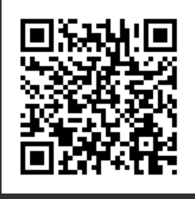
Pre-programme survey & break
Notes:
The Child Sexual Abuse Practice Leads Pre-Programme survey (Social workers): https://www.surveymonkey.com/r/Pre_progPLPSW
Allow 45mins.
Tell participants survey will take up to 30 mins and to factor this in when taking a break.
Remind participants this is not an opportunity to log on and check emails / complete case notes!

Slide 31
Embedding the Programme

Slide 32
What we need from you as practice leads
Commit to the whole programme, keep to time – stay to the end
Keep cameras on
Be an active participant in discussion and group tasks
Ensure they cannot be interrupted or overheard.
Bring case material for the afternoon discussion
Engage in the course material and read materials shared
Ensure no meetings are booked and time is protected
Complete surveys at start, end and brief surveys before each reflective session
Notes:
Read through below and ask participants if they have any concerns about this or can foresee any issues.
Commit to attending the full programme
Engage fully in both the taught and reflective learning sessions:
Bringing case material
Engaging in course activities
Applying learning to practice in between sessions
Undertaking any suggested reading.
Complete the online evaluation surveys at the start and end of the programme and the two question survey at the start of each afternoon reflective session
Remind those attending that they will have all received the pre course training engagement information. This is just a helpful summary, in case they forgot.
In addition to above
Keep microphone muted to limit background noise and interruptions.
Do not record this session – a full copy of the slides will be shared with all delegates
Ask questions and complete the evaluation at the end – let delegates know how to ask Q’s – in the chat, virtual hand or shout out.
And of course, add anything else that is particularly relevant to your session/delivery style.

Slide 33
What we have asked from your managers
Ensure
Ensure your practice lead’s time is protected to attend
Ensure
Ensure your practice lead is able to commit to the 11-month programme and beyond
Ensure
Ensure your practice leads understand your organisation’s expectations of them
Ensure
Ensure your practice lead is given opportunity to disseminate their learning
Ensure
Ensure your practice lead are allocated cases where there is known or suspected, child sexual abuse
Ensure
Ensure you use supervision to check in regularly with them on the impact of programme and consider other ways you can ‘check-in’ with them
Familiarise
Familiarise yourself with the CSA Centre’s key resources and how your practice lead will be using these

Slide 34

Preparing for the programme
Practice Leads:
What do you need from your line manager?
What do you need from your Senior Manager/organisation?
What do you see as the particular opportunities and challenges of the role?
Notes:
Embedding the Programme - Preparing for the Programme.
Open this slide up for general discussion

Slide 35

What we have asked from your managers continued…
We have recommended:
  Be aware of the emotional impact of this programme on your practice leads
  Add as a regular supervision agenda item
  Regular check ins
  Prioritise attendance
  No other work on session days, out of office on
  Remember, there is course facilitator support
Notes:
Embedding the Programme - Support During the Programme.
This is based on learning from the previous pilots.
Emotional impact can be significant, particularly for those with lived experience – this needs to be named when talking through this slide.
Discussion of how facilitators support leads should be done here – i.e. 1 - 1 check in during the programme, and then contact details shared for when people may need to speak outside of this.
We recommend:
Being aware of the emotional impact of the programme on the Practice Lead
An agenda item to be added to supervision based on the programme and its impact
Allocating cases of child sexual abuse to Practice Leads
Line Managers to check in regularly with Practice Leads
Line managers to commit to prioritising Practice Lead attendance on the programme
No other work on session days, out of office on
Practice Leads to link in with course facilitators, when needed

Slide 36
Your role in practice…

Slide 37
Practice Lead role options proforma
Provide monthly briefings at team meetings to share their learning from the course
Offer bite-size training sessions to other teams/groups of colleagues
Share resources from the training
Be allocated cases of child sexual abuse, when they come in
Provide support to colleagues, when they are dealing with cases of child sexual abuse
Offer consultation / drop-in sessions for colleagues who are dealing with cases of child sexual abuse
Co-work child sexual abuse cases with colleagues (as part of assessment or intervention)
Represent their agency in multi-agency discussions / meetings, about child sexual abuse
Advise on the development of local policies and procedures
Represent our organisation at external events, related to child sexual abuse
Or are there other ways in which you would like your practice lead to take forward their role? Please describe what these are
Notes:
Group exercise – You should have received a proforma form in word format. Hopefully your line manager has shared their feedback from their introduction session with the CSA Centre, held a month ago. During this session, they completed a practice lead role options proforma. This enabled them to think about how they could best utilise all of you, once you have completed the programme. If you have seen this already, please feedback to your group. If not, start to think as a group, how you can best utilise your training and development within your organisation.
Split into groups and allow 10 minutes to complete their word copy of the proforma. Return and allow brief group feedback

Slide 38
Sustaining the role as a practice lead
With strong senior management commitment to embedding the Practice Lead role, the effectiveness of the programme is highest and practice development more likely to be sustained.
Some of the ways to maximise this are as follows:
Supporting the Practice Leads to continue to meet as a group after the end of the programme
Offering opportunities within existing meetings, to share their learning and establish their role.
Tell people within the organisation about the role.
Using existing ‘knowledge hubs’ where resources can be shared across the organisation
Notes:
Sustaining the role
We know from earlier programmes that where there is strong senior management commitment to embedding the Practice Lead role, the effectiveness of the programme is highest and practice development more likely to be sustained. Some of the ways to maximise this are as follows:
Supporting the Practice Leads to continue to meet as a group after the end of the programme on a monthly/six weekly basis for two hours. This could offer peer support, a space to plan further dissemination work, strengthening or development of protocols and processes, ongoing planning around embedding the role.
Offering opportunities within existing meetings, such as Senior Management Team meetings, Practice Forums, Community of Practice events, for the Practice Leads to share their learning and establish their role.
Organising regular mailshots/inclusion in staff newsletters which tell people within the organisation about the role. This can be supported by Practice Leads adding ‘Child sexual abuse Practice Lead’ in email signatures.
Using existing ‘knowledge hubs’ where resources can be shared within the wider organisation.
Some local authorities have chosen to set up in-house consultation offers led by Practice Leads. To support the transition of Practice Leads from undertaking the course to offering consultation to colleagues within their organisation, some have chosen to invest in the child sexual abuse Centre’s post-Practice Leads Programme consultation offer. This is a 12 month programme of monthly 2.5 hours sessions facilitated by the child sexual abuse Centre alongside the qualified Practice Leads – for more information see here.

Slide 39
Lunch
Notes:
Managers to leave the session.

Slide 40
Hearing from the Practice Leads
Notes:
A time for PLs to meet each other and think about their hopes and fears

Slide 41

Introductions
In pairs, discuss the following and then feedback to the larger group, introducing yourself and not your partner
Name and role
What you want to get from the programme
One word or phrase that sums up your personal response to the prospect of working with child sexual abuse – all feelings are allowed!
Rating out of ten – how comfortable do you feel responding to this issue?
Notes:
Put participants into breakout groups of pairs. 10 minutes in pairs and then feedback to the group. Allow enough time for the participants to speak fully and explore any anxieties they may hold.
Explain that we will be exploring feelings further throughout the afternoon.

Slide 42
Key principles and challenges in practice

Slide 43
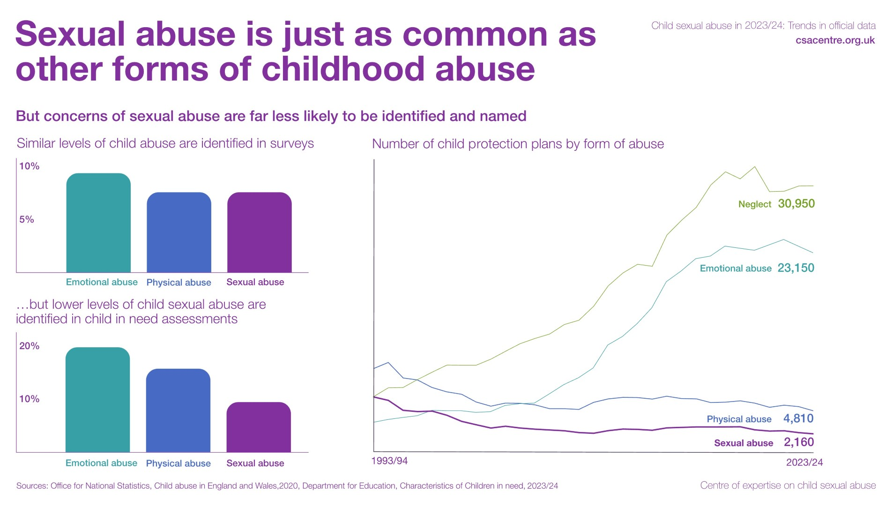
Notes:
There is a misapprehension that child sexual abuse is rare, but survey data shows it is just as common as other forms of childhood maltreatment
Despite this, child sexual abuse is less likely to feature as a child protection plan than other forms of child maltreatment.
In the latest data, there was a huge increase in the number of plans due to neglect and emotional abuse, but the number of plans due to sexual abuse have declined over the past 25 years.
Our other research shows that social workers lack confidence to name and record sexual abuse.
So the overall picture remains the same – while child sexual abuse is as prevalent as child physical abuse and only marginally less prevalent than emotional abuse, the lowest assessments recording concerns of child sexual abuse continue to form the lowest category of child abuse.
However, the most recent review of data demonstrates that the number of children in England placed on child protection plans because of sexual abuse concerns fell to a record low of 2,160
The overall number of new child protection plans fell by a more modest 3%, with child sexual abuse being the reason for just 3.5% of those plans – the lowest proportion ever recorded.
The demographic profile of children placed on child protection plans because of sexual abuse concerns remained similar to previous years. These children tended to be older than those placed on protection plans for other reasons, and three-fifths were girls. Compared with the population of children attending state schools and nurseries in England, they were less likely to be of Black or Asian heritage
Across local authorities in England, there was considerable variation in the number of children placed on child protection plans because of sexual abuse concerns, but more than twothirds of local authorities placed no or very few children on protection plans for that reason.
For info - No information about children’s services’ identification of, or response to, child sexual abuse in Wales during 2023/24 was published in time to be included in this report

Slide 44
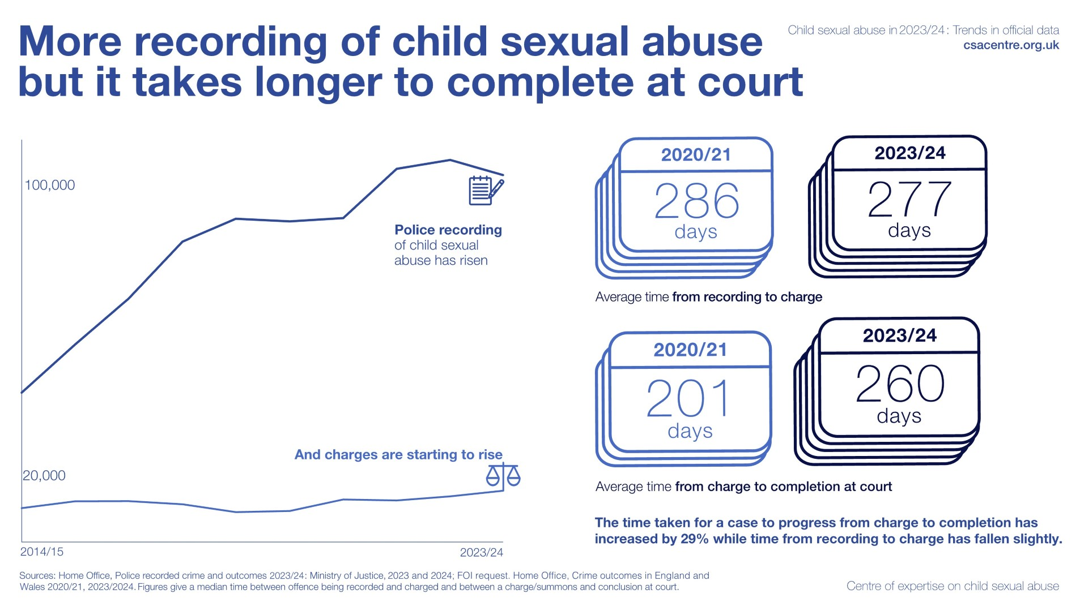
Notes:
In criminal justice, we see quite a different trend. The number of reports of child sexual abuse offences has gone up many-fold in the last 10 years. Doesn’t relate to there being more crime, but more victims willing to come forward and better recording.
police forces in England and Wales recorded over 101,000 child sexual abuse offences in 2023/24 – the third year in a row where police forces recorded over 100,000 offences. They recorded more charges brought against suspects of child sexual abuse in 2023/24 (13,098) than ever before. In courts, proceedings were brought against 9,215 defendants for child sexual abuse offences in the year to December 2023, which is the highest number since 2016 and 15% more than the previous year.
Despite these promising trends in criminal justice, 60% of investigations into recorded offences continue to be closed with no further action due to evidential difficulties.
For the first time, our report also looked at data on what happens to people after they are convicted of child sexual abuse. We found that one in eight convicted prisoners in England and Wales are serving sentences for sexually abusing children, bringing the number of people in prison for child sexual abuse offences to the highest level since 2015. In 2024, a record 70,000 people were being supervised by the police, prisons, or the probation service following conviction for sexual offences against adults or children in England and Wales.

Slide 45
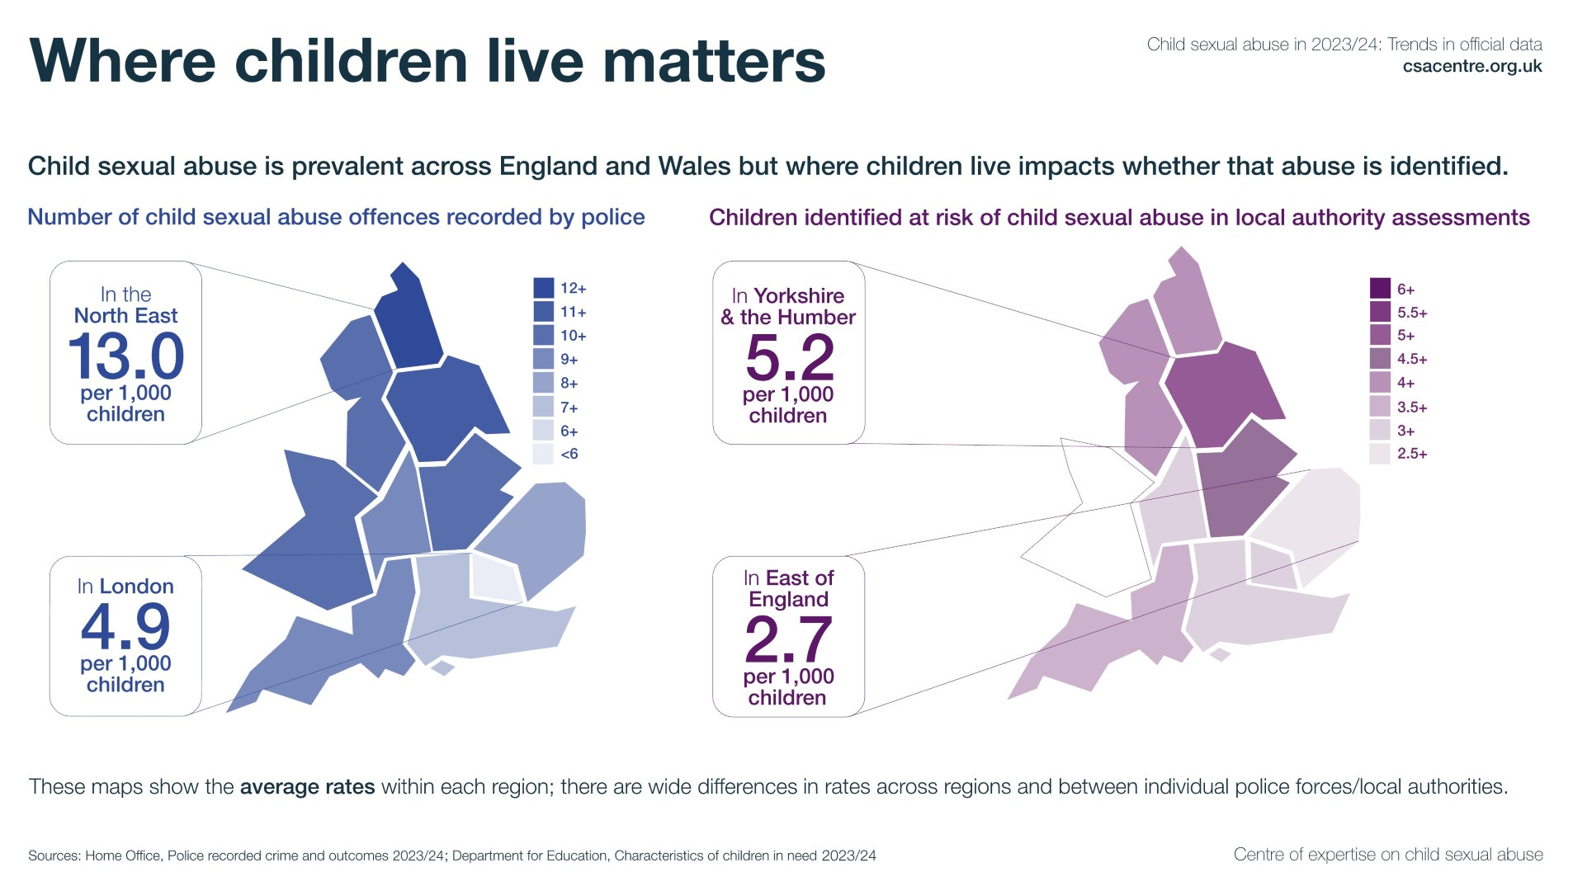
Notes:
There are large variations in agency identification of child sexual abuse in different regions of England and Wales. In order to compare smaller and larger regions we have taken into consideration the local child population. We can see that when it comes to police recorded child sexual abuse offences, there are over two-fold differences between the lowest region and the highest. In London, just 5.6 child sexual abuse offences were recorded for every 1,000 children living in this region, while in the North East, nearly 13 offences for each 1,000 children were recorded.
The variation is even larger in children’s services identification of child sexual abuse in assessments (this includes also identification of child sexual exploitation in assessments). While in East of England just 2.8 assessments for every 1,000 children noted concerns of child sexual abuse or exploitation, in the Yorkshire and Humber this rate was 6 for every 1,000 children.

Slide 46
Societal reactions to child sexual abuse and the impact of this

Slide 47

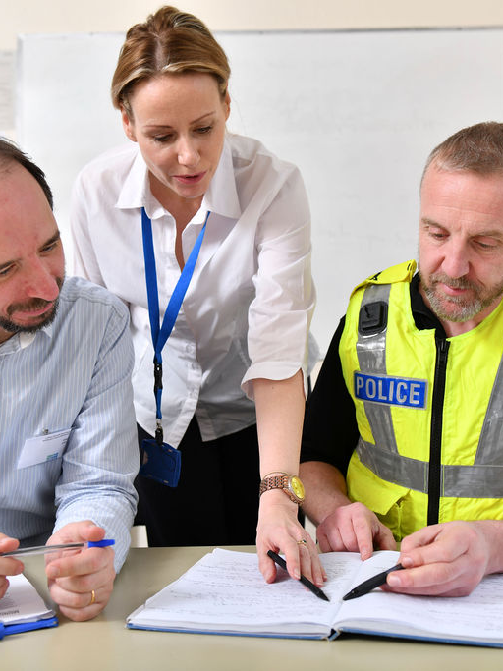

Our response has always been reactive
A pendulum swinging between media panics
Notes:
Child sexual abuse elicits strong emotional responses from everyone who comes into contact with it. As a result, the way society (and professionals) deal with sexual abuse is often very reactive.
We can see throughout the last 100 years or so, how the pendulum has swung dramatically in terms of response to the suggestion of abuse.
Freud - False Memory Syndrome
From middle-upper class Austrian society, who recoiled at Freud’s suggestion that many of the young women he was analysing had experienced sexual abuse from their fathers, which led to the suggestion that their memories were in fact fantasy (sowing the seeds to the later ‘false memory syndrome’, for which there is no scientific evidence )
Cleveland
Cleveland Inquiry in the early 1990’s, during which nearly 100 children were thought to have been mistakenly removed from their families as a result of prolific sexual abuse.
Parents were given airtime on Breakfast TV saying ‘come back to me my child, these evil social workers have taken you away’ – and as a result the majority of those children were returned home. Very quietly, around 10 years later, it was revealed that in around 85% of those cases, there was evidence of sexual abuse, and yet the public outcry led to them being returned home.
Jimmy Saville/BBC
Catholic Church
Me too
Everyone’s invited
CSE focus Rotherham/Rochdale – Asian grooming gangs rhetoric
What we have seen is that there is often a particular focus on one type of harm which risks stopping us looking at all forms of child sexual abuse.
Over the years we have seen a reduction in dedicated training on child sexual abuse, especially child sexual abuse that takes place within the family - This gap in knowledge leaves room for myths about sexual abuse to proliferate; where we are more easily influenced by media stereotypes and personal assumptions, than research evidence and current theory.
Leads to assumptions…
That men who are ‘good with children’ do not sexually abuse them
That if children say they want to see their abusive parent, they cannot be abusing them
That if children don’t appear distressed when making a disclosure, then it must be untrue
Sexual abuse is a hidden harm and sexual abuse within the family especially so.

Slide 48



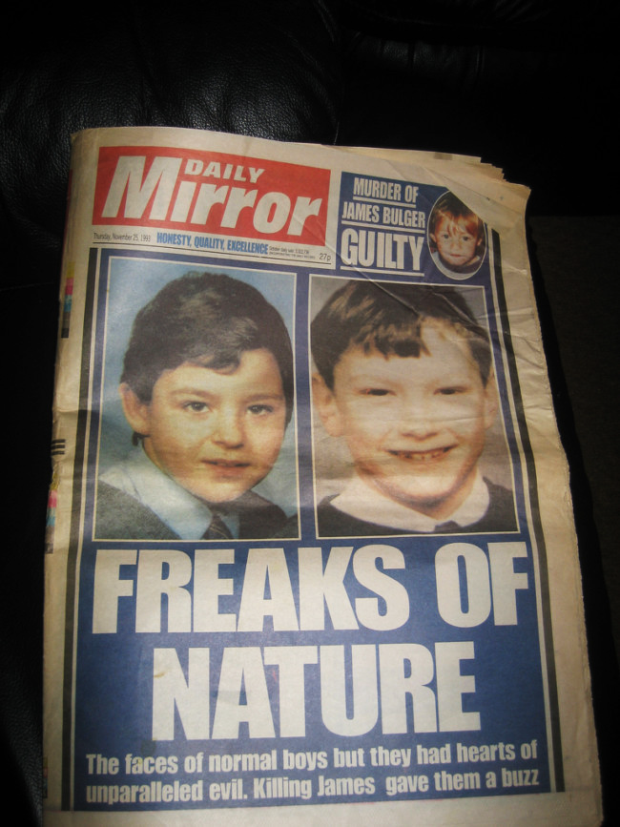
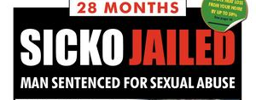
Notes:
This has done nothing to dispel the myth that all abusers are either ‘monsters’ or others who are ‘not like us’.
This is not reality, yet it is a more comfortable situation for us to accept.
We see abuse as happening out there…..
Not in our families – but…
In Institutions
By groups of South Asian Men
By priests
By BBC Personalities etc.
And it prevents us from recognising that those who abuse children are also human beings.
Often in the family setting……..
Partners
Friends
Parents etc.
So when we think someone is otherwise a good person, we cannot hold in mind that they may also be abusive.
We are left with the view that we can ‘Tell by Looking’.

Slide 49

Assumptions that follow the stereotypes…
That we can tell by looking
That men who are ‘good with children’ do not sexually abuse them
That if children say they want to see their abusive parent, they cannot be abusing them
That if children don’t appear distressed when making a disclosure, then it must be untrue
Notes:
Assumptions that follow the Stereotypes.
If we actually applied what we know about sexual abuse, we would realise these assumptions are incorrect. Trainers can talk through each of these.

Slide 50

What are the obstacles in practice?
In small groups/group discussion
(10 minutes)
Individually
Organisationally
Systemically
Please nominate a spokesperson to take notes.

Slide 51









The obstacle of fear
What if I’m wrong
Notes:
The Obstacle of fear.
Trainer Note - Some of these would have been fed back in previous exercise - Need to make sure all covered.
Fear of accusing someone of sexual abuse (can feel worse than accusing someone of murder!).
Fear from not knowing how to ask, or what to say in response.
Fear of thinking the unthinkable, having to think about people doing abusing things to vulnerable children.
Fear of ‘opening a can of worms’ – generally as professionals who work with children we believe that it is important to talk about things that happened in our pasts – we talk about death, loss, drugs, trauma, violence – and yet when it comes to sexual abuse we say we don’t want to ‘open a can of worms’. Survivors tell us that they are already living in the can – so being asked a question in the right way, isn’t going to make this worse. Is this response from us, more about us being worried about hearing the information and dealing with distress?
Fear of getting it wrong – if we are always asking ‘what if I’m wrong?’ we will be always looking for evidence to back this up – so we need to switch from saying ‘what if I’m wrong?’ to ‘what if I’m right?’
Fear of the situation escalating.
Fear of breaking up families.
Fear about increases in already busy workloads.

Slide 52
It can feel like a bit of a minefield
Asking questions…
Notes:
COMMON FEAR OF CONTAMINATING EVIDENCE
One of the biggest obstacles for most practitioners is the fear of contaminating evidence.
All Research - Children & YP & Adults = ‘We Need Help To Tell’ BUT - most professionals are frightened to ‘ask’
This slide is designed to bring out the following….
To highlight the prioritisation of the criminal justice system, and the fact that many children are not getting their needs met due to cases closing when the Police take NFA.
To demonstrate how the system response reflects the abuser’s threats.
To demonstrate how hard it is for children to repeat their disclosures.
This is an interactive session - Trainer posing questions around a set of circumstances.
Suggested script:
Trainer.
Imagine for a minute a 7 year-old boy telling his teaching assistant (TA) ‘Daddy played with my willy in the bath’.
Bearing in mind this ‘fear of asking’, how do you think the TA is likely to respond?
Prompt if needed – someone may say ‘they’d go to their SENCO (Special Educational Needs Coordinator), so ask…
But before that, in that moment, what might they look like in that moment?
What might they immediately think?
Participants desired response…..
Shocked.
Might Freeze - Panic
‘Oh No’
‘I don’t know what to say’
‘I mustn’t say the wrong thing’
Trainer.
It is hard to think of any other occasion when a child says something to an adult about their evening/weekend, and the adult freezes, however with this, this is the likely response.
Now what is it likely that the abuser has told the child will happen when they tell?
Participants desired response…..
That they won’t be believed.
Trainer.
Yes.
You won’t be believed.
They’ll think you are lying.
They’ll think you are disgusting.
So in that very moment, the abuser’s threat has been confirmed.
Now, what is the next thing the abuser is likely to say will happen if they tell?
Participants desired response…..
That they’ll get into trouble.
That they’ll be taken away.
That their mum/dad will get into trouble’.
Trainer.
Right.
Who is it that next comes to speak to the child?
Participants desired response…..
Another Teacher - SENCO.
A Police Officer.
Social Worker.
Trainer.
Exactly.
So now the abuser is growing in power in the child’s mind.
Everything that the abuser has said will happen, is now happening.
So if the child actually manages to repeat this allegation to the social worker and police officer (despite the threats of the abuser), that in itself is remarkable.
But if they do, what is it that happens next?
What is it the abuser has said to the child will happen when ‘mum finds out’?
Participants desired response…..
She will be…..
Angry.
Upset.
Distressed.
Trainer.
Exactly.
What happens when mum finds out?
Participants desired response…..
She is……
Upset.
Angry.
Distressed.
Trainer.
So again the power of the abuser has grown.
The police and Social Worker may further speak to the child, do further ‘Q & A’ and again, if the child chooses to repeat their disclosure, despite all the things that the abuser said would happen, happening, then that is extremely brave.
Many children, perhaps quite wisely in the context of the threats by the abuser, do not repeat their allegation, or some go as far as to retract it.
I think it’s incredible when children actually manage to repeat their disclosure during Q & A, and if they do that, agree to an ABE interview, and then give evidence to the court.
Actually, what most often happens is the child does not repeat the disclosure in the way we need them to, so the police take ‘no further action’ because they can’t, because verbal evidence is ‘evidence in chief’ and so if the child cannot verbalise their concerns, their evidence will not stand strongly in court.

Slide 53
Investigation outcomes of child sexual abuse offences England and Wales, 2022/23
Notes:
Investigation outcomes remained in line with findings from previous years:
- 11% concluded with a charge of the suspect
- 4% with a caution, diversion or out of court resolution
- 10% outcome 21
- 5% with prosecution prevented or not in public interest
- the remaining two thirds closed due to some form of evidential difficulties
So the increase in charges that appear to be happening as a result of rape review for adult offences hasn’t had an impact on child sexual abuse.

Slide 54

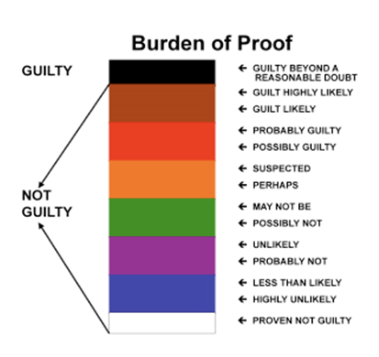
The Burden of Proof
Beyond Reasonable Doubt
Balance of Probabilities
Notes:
The Burden of Proof.
AIMS:
To highlight that we have different burdens of proof.
To demonstrate the need to understand our responsibilities within safeguarding.
To demonstrate the need to talk to one another.
Suggested script:
It is important to remember that the police and children’s services have different ‘burdens of proof’ – with the Police needing evidence to prove ‘beyond reasonable doubt’ and Children’s Services needing evidence on the ‘balance of probabilities’.
If you look at the top half of the ‘beyond reasonable doubt’ picture – the black indicates beyond reasonable doubt, however the next ones down are ‘guilt highly likely’, ‘guilt likely’, ‘probably guilty’, ‘possibly guilty’, ‘suspected’ and ‘perhaps’. So although the Police may not be able to take further action because there isn’t enough evidence (at this stage) to indicate ‘beyond reasonable doubt’, the remaining categories absolutely fit with ‘on the balance of probabilities’. So, if a child has reported sexual abuse (even if they weren’t able to repeat it, or they retract it), and there are other indicators of concern for the child or in the family identified in assessment, then on the ‘balance of probabilities’ this child needs a response from Children’s Services, that is more than case closure. In fact, are we not failing in our duties to safeguard and support children if we don’t do this?

Slide 55
The implications of a ‘no further action’ decision
An NFA decision from Police/CPS has undue influence over the remainder of the system’s response to children.
The police have taken NFA so there’s nothing we can do
There’s no evidence the child has been abused
The child made must have made this up
I can’t say I believe the child if there is no evidence for it
There is no evidence this child was previously abused
We can’t refer to specialist help as there’s no evidence it happened
The family won’t work with us now, and we don’t have the evidence to make them
Notes:
And then professionals do not know what support can be provided to children when there have been concerns of child sexual abuse...or what can be said to them.
Myths proliferate in relation to talking to children about sexual abuse
Children are not told when there is sexual risk within their families
Children are not spoken to during investigations or when NFA decisions are made
The legal basis for information-sharing and consent is misunderstood
There is a lack of guidance for social care, early help and universal services on what can be done with children and families in the absence of a prosecution

Slide 56

No Further Action
What does it mean?
No further action is when the Police/CPS make a decision not to charge someone with an offence. This may be because there is not enough evidence or it is not in the public interest.
It does not mean the child has not been believed or listened to
It does not mean that agencies walk away because there is nothing that can be done
It is not the time to decide what support can be given. That should already be happening.
It does not mean that an investigation cannot be restarted should further evidence come to light
Notes:
Self explanatory slide

Slide 57
Recommendation 3: Enquiries and Investigations
Safeguarding partners to audit and review local guidance and practice so that a clear distinction is made between thresholds about significant harm to a child and those influencing criminal investigations.
Safeguarding decisions must be based on all indicators of sexual abuse and should not rely solely on verbal statements from children.
At the conclusion of section 47 enquiries and police investigations, there is a multi‑agency discussion to consider risk to the children and how they will be protected and supported.
The term ‘no further action’ should not be used in these circumstances as it is too often understood to mean the abuse did not happen. The term ‘no further police action at this time’ is more appropriate. There should be a clear record of why a criminal investigation has been closed and that this information has been shared with other relevant agencies.
“I wanted them all to notice”: Protecting children and responding to child sexual abuse within the family environment (Child Safeguarding Practice Review Panel, 2024)
Notes:
This is from one of the recommendations “I wanted them all to notice”: Protecting children and responding to child sexual abuse within the family environment (Child Safeguarding Practice Review Panel, 2024).
The Government should take necessary steps to improve the quality of joint enquiries so that decisions are more consistently in children’s interests.
This review reveals that the criminal standard of proof pervades decision making throughout the child protection system and beyond, which prevents many children who have suffered sexual abuse receiving the help and protection they need.
Responding to this should include:
requiring safeguarding partners to audit and review local guidance and practice so that a clear distinction is made between thresholds about significant harm to a child and those influencing criminal investigations. Safeguarding decisions must be based on all indicators of sexual abuse and should not rely solely on verbal statements from children.
make any necessary changes to Working Together guidance to clarify that a section 47 enquiry concludes when the multi‑agency group who have led the enquiry decide together if there are outstanding concerns, and if so, to notify relevant agencies so that any necessary actions needed to safeguard the child and/or other children can be considered.
when applicable, that the child’s records should state ‘no further police action at this time’, with an appropriate explanation, instead of ‘no further action’. Too often when the police record that they are taking no further action it is understood by other professionals to infer that the abuse did not happen.

Slide 58
Key principles
To summarise
Secrecy and silence are the best friends of sexual abuse
Not ‘what if I’m wrong?’ but ‘what if I’m right?’
‘No further action’ does not mean the child has not been abused
Evidence is broader than verbal disclosure
We all have a role to play
Sexual abuse takes place in many different and overlapping contexts
The majority of sexual abuse goes undetected

Slide 59
Break
Notes:
Managers to leave the session.

Slide 60
Impact of this work and self-care

Slide 61
Thinking about the impact on us
Our own life experiences
The nature of the work
Societal attitudes
Other pressures

Slide 62

The impact of the work
How might this work impact us?
How do you feel about working with:
Children who have been, or are being, sexually abused?
Adults who have sexually abused children?
Children who have displayed harmful sexual behaviour?
Non-abusing parents and carers?
How do you think this might impact you personally?
Notes:
Allow 20 mins for the small group discussions, and a further 20 mins for discussion as a larger group.
See next slide for areas which might be raised

Slide 63
The impact on you
Supporting family members to cope with and recover from the impact of sexual abuse can have a psychological and emotional impact on you as a professional
The effects can include:
• Feeling overprotective towards children in your life
• Having trouble sleeping
• Feeling angry, frustrated or disillusioned
• Finding it difficult to empathise.
Maintaining your energy levels, and your feelings of self-worth and self-esteem, is essential to ensure that you can work effectively and preserve your own emotional wellbeing
Notes:
Run through these points if they haven’t been picked up in the previous discussion. There may be difficult subjects that come up which are hard to name such as the impact on our sex lives and the group may need support to refer to these.

Slide 64
Community reactions to our work
Reluctance to discuss work with family – concerns about confidentiality, tiredness, fear of contaminating them in some way
Not wanting to tell people what you do: ‘conversation killer’
Others telling you about their experiences
Accusations that too little provided for victims
Accusations of being a ‘protective advocate’ of those who abuse children
Alienation
Notes:
Some of the things people may say to us when we say we work in this field.

Slide 65
Managing impact
Group discussion
Notes:
Group discussion – what are the things that you do to look after yourselves in your work?
Does anyone have strategies which they want to share?

Slide 66

What can you do?
Acknowledge impact
Make a commitment to talk about the impact of the work
Express distress and negative emotions
Separate out issues of competence from aspects of impact
Respond proactively
Manage your energy: physical, emotional, mental and spiritual
Meaning: at the start and throughout your career (explore in supervision regularly)
Know your strengths and vulnerabilities

Slide 67

Grounding exercise
5 things you can see
4 things you can feel
3 things you can hear
2 things you can smell
1 thing you can taste
Notes:
The goal is to calm your mind by using your five senses to focus on your environment instead of your thoughts.
Here are the steps to complete this exercise:
First, notice 5 things that you can see. Look around you and become aware of your environment. Try to pick out something that you don’t usually notice.
Second, notice 4 things you can feel. Bring attention to the things that you’re currently feeling, such as the texture of your clothing or the smooth surface of the table you’re resting your hands on.
Third, notice 3 things that you can hear. Listen for and notice things in the background that you don’t normally notice. It could be the birds chirping outside or an appliance humming in the next room.
Fourth, notice 2 things you can smell. Bring attention to scents that you usually filter out, either pleasant or unpleasant. Catch a whiff of the pine trees outside or food cooking in the kitchen.
Finally, notice 1 thing you can taste. Take a sip of a drink, chew gum, or notice the current taste in your mouth.

Slide 68



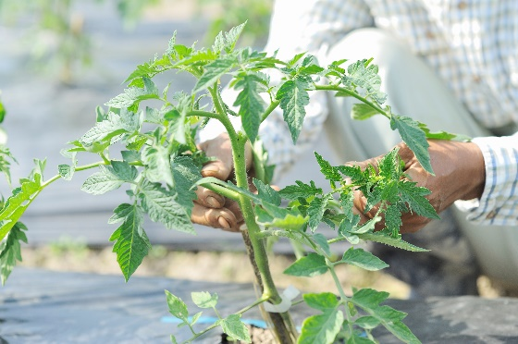


Taking care of yourself
Notes:
Spend a few minutes thinking about what you do to take care of yourself and what more you could do.

Slide 69


If you are affected by anything discussed today…
The Survivors Trust - Helpline: 08088 010 818
Find help, support and advice in your area:
https://www.thesurvivorstrust.org/
Rape Crisis helpline 0808 500 2222 (24 hours)
www.rapecrisis.org.uk
National Association for People Abused in Childhood 0808 801 0331
https://napac.org.uk/
SurvivorsUK
Online help for male survivors of sexual abuse and rape.
https://www.survivorsuk.org/

Slide 70

Stop It Now! helpline
If you are worried about your own thoughts or behaviours or are worried about the behaviours of someone around you, you can contact the Stop It Now! helpline for free, confidential advice:
0808 1000 900

Slide 71
Any questions?
For more information please contact:
plp@csacentre.org.uk
Notes:
Any Questions?
Present information on slide.

