Slide 1
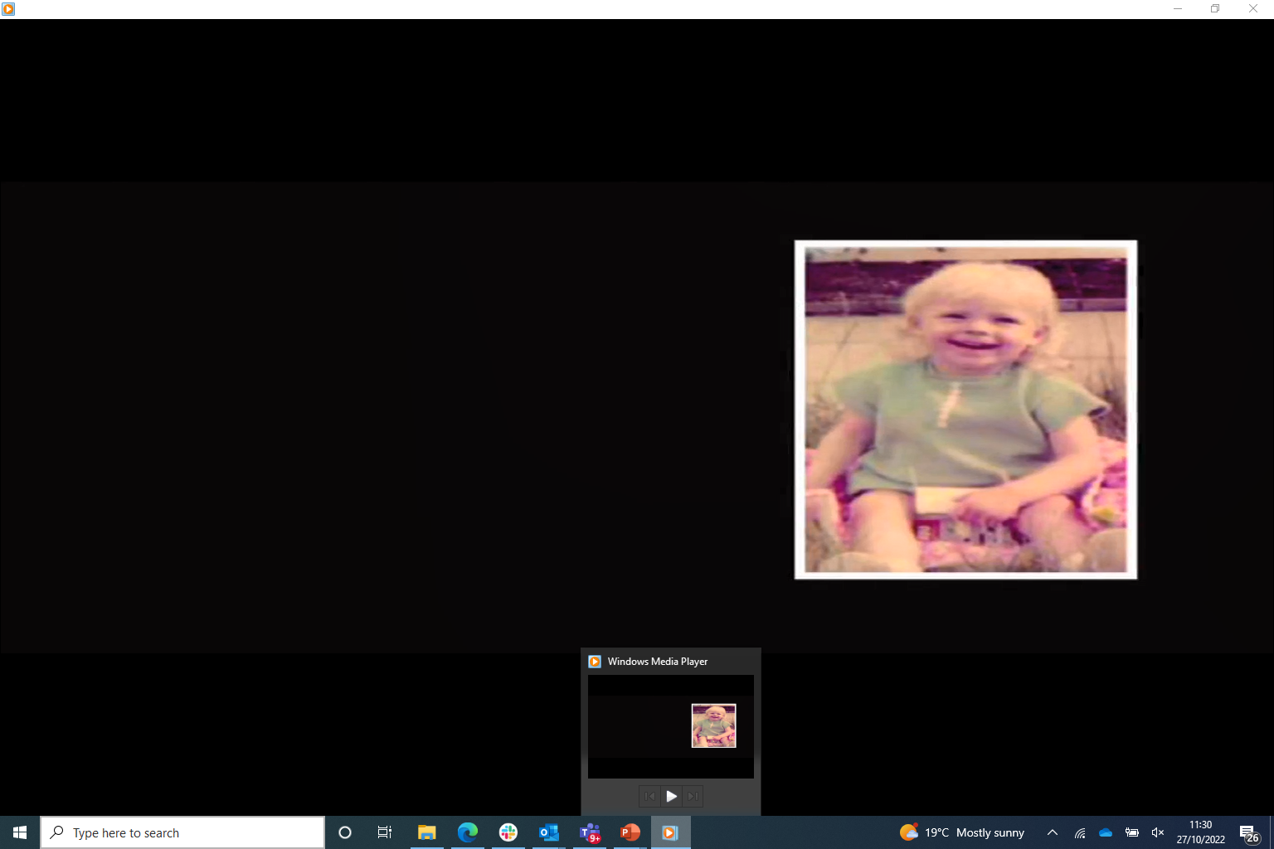
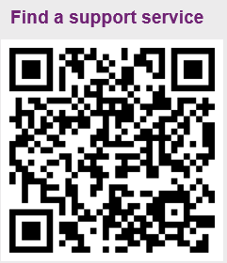
Susan
We will watch the video.
Please make notes of any thing that stands out for you during this.
Remember to look after yourself and step away if needed.
Notes:
Susan – note – see separate trainer notes
Main points:
Trainer Note - Video is to be played to group (12 Mins Long).
Group discussion to follow.
Encourage participants to take notes.
Signpost Self care Tips prior to showing the video as the video has details of abuse.
Think about the headings we have been through

Slide 2


Slide 3
Susan – Group discussion
Notes:
Susan – note – see separate trainer notes

Slide 4
Impact for victims - survivors in ethnic minority communities
Losing touch with aspects of their culture or identity
Distancing self from communities for emotional and physical wellbeing
“It was because I was different from the rest of the people that did what they did, and my sense of identity’s been lost ever since.”
Male focus group participant
“Well, actually I’m estranged from my family, but when I was part of that community I – I miss – I miss the community feeling a lot, but one of the things that I really miss is the food. It’s like every time we used to get together with my uncles and aunts, it would be like amazing Indian food.”
Female focus group participant
(IICSA, June 2020)
Notes:
Main points:
Impact for Victims in Ethnic Minority Communities - Simple read through of slide.
Additional information:
https://www.iicsa.org.uk/publications/research/child-sexual-abuse-ethnic-minority-communities

Slide 5
“The ways the outcomes or impacts in each of these areas emerge and subsequently play out in the lives of victims and survivors constitutes a complex and dynamic process. The outcomes in these areas have been shown to interact with, cause, compound or (in some cases) help to mitigate outcomes in other areas” (IICSA, 2017)
- anxiety
-depression
-eating (over / under / restrictive)
-sleep disruption
-feelings of shame & guilt
-post traumatic stress response
-self harming behaviours
-immediate physical impacts
-sexually transmitted infections
-chronic illness such as arthritis
-traumatic sexualisation
-impact on sexual functioning
-confusion about bodily responses
-impact on relationship satisfaction, stability & emotional investment
-enhanced empathy
-parenting difficulties
-feeling fearful they will abuse their own child
-lower levels of spiritual wellbeing
-protective factor providing psychological and emotional comfort.
-negative impact on attainment
-act as a proactive factor
-associated with lower employment rates and self reported financial stability
Notes:
Main points:
Use this slide to pick up on the points the group have noted watching the video of Susan
Note – read out the quote at the top of this slide
This quote is taken from the rapid evidence assessment on the impact of child sexual abuse and explains the interaction between direct impacts, how victims and survivors live and cope with the impacts, and resulting outcomes
Get some impacts and responses to Susans story

Slide 6
How impact differs…
The nature of the abuse
Whether the abuse is chronic
The relationship between the child who has been harmed and the person who has harmed them
The nature of the child’s previous life experiences
The support within the family and wider support networks
The child’s inherent resilience
Notes:
Main Points:
Aim: to help people to think about how the impacts of abuse can be different for different children, depending on the factors listed. When we think of sexual abuse and the impact of it, we can feel overwhelmed by its effects – however, sexual abuse is a spectrum of experiences – from, for example, being touched once over clothes to being chronically sexually abused over a period of years.
Most importantly, while it can affect every area of a child’s development, abuse is not destiny. Children, young people and adults want us to have hope in their recovery. People can and do recover from abuse.
Some key indicators of level of impact are:
The nature of the abuse – penetrative abuse is found to be more harmful to longer term mental health than non-penetrative abuse
Whether the abuse is chronic – being abused repeatedly over time is likely to cause more harm than being abuse on 1 or a few occasions.
The relationship between child and person who has harmed – being abused by someone who should be loving and caring for you is more likely to have a bigger impact on mental health outcomes than being abused by someone who is not in this role. So, abuse by a main carer, such as a parent, is a particularly harmful experience. Confusion around sex and intimacy is common in these situations. Abuse by siblings can, however, be as impactful as abuse by a parent.
The nature of the child’s previous life experiences – if a child’s life prior to the abuse has been fairly supportive – no other abuse or neglect within the family, positive friendships and schooling, then they are likely to fare better than if they have already experienced abuse, difficulties and other adversities.
The support within the family and wider support networks – being believed by your main care giver is thought to be one of, if not the most, important factors for recovery from sexual abuse. It is as reparative as a positive criminal justice outcome, or indeed therapy. As such, we need to focus our efforts on helping non-abusing parents believe their children in those situations where they do not yet believe – this will be our best chance of reducing the longer-term impact on mental health. Not being believed is particularly harmful
This point in particular can be useful to talk to non-abusing parents about – when abuse happens in a family it is like a bomb going off, and parents often feels like they have failed their child in the worst way possible. Being able to say to parents that by believing their children they have already done the most important thing in helping their child’s recovery, can be empowering for those parents
The child’s inherent resilience – resilience is an interesting concept in that we are all resilient or not at different times in our lives. However, research indicates that some children have more ‘resilience’ than others. We need to ensure we are talking about resilience and not stoicism. True resilience is the ability to cope with, adapt to and move on from an experience of stress or adversity, some people have been described as resilient when they were being stoic and really wanted the opportunity to not be
This framework can help us think about the impact on the particular child we are working with and the level of service they may need.
End this slide by highlighting again that abuse is not destiny, we hold a sense of hope for all victim- survivors

Slide 7
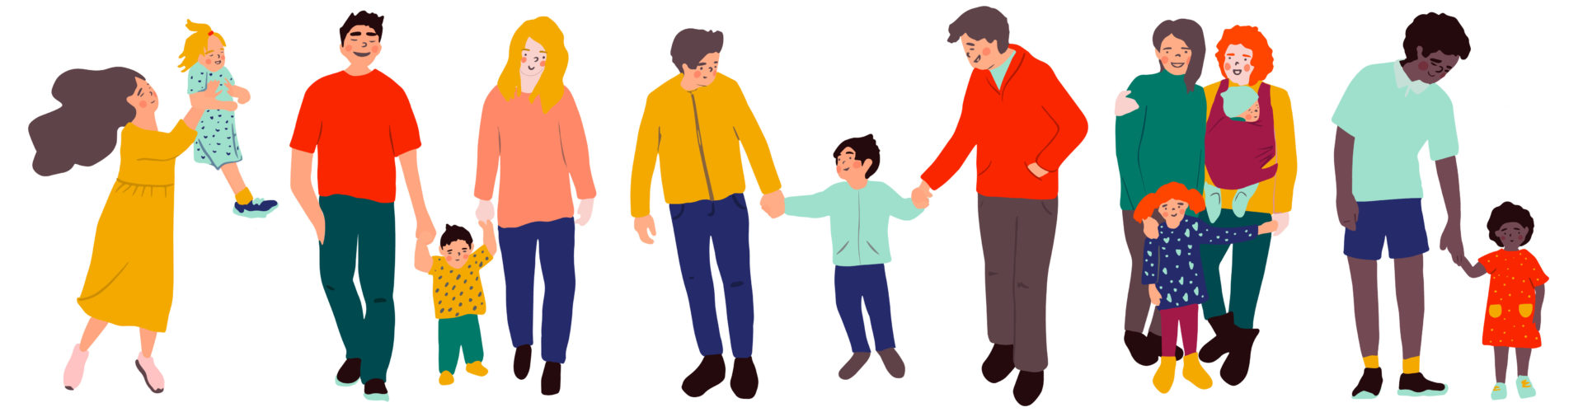
Impact on family
Torn loyalties
Guilt
Blame
Distress
Anger
Jealousy
Notes:
Main points:
When we think about sexual abuse and its impact, we often think about the impact of the abuse on the individual child – and as a result if we do anything with the family, we send the child off for individual intervention. Actually, what many victims- survivors tell us is that they were able to recover from the physical instances of the abuse, but not the impact the abuse had on every family relationship.
When abuse has taken place it is an absolute corruption of family relationships – non-abusing parents can feel so guilty they can no longer offer their children physical affection; parents can be angry with one another for not protecting their child; the parent whose own parent or family member has abused their child feeling guilty, or being blamed by association by the other parent; siblings who may already feel jealous of the attention the victim was getting and who now cannot see the person who has allegedly harmed feeling angry with the victim; siblings feeling guilty about not recognising the abuse or stopping it if they were aware of it; siblings who were made to be the ‘lookout’. Many different ways in which family relationships are harmed significantly.
If we as professionals find it difficult to talk about sexual abuse, then we can pretty much guarantee that families will not be talking about it either. We can be good at talking to children on their own, or talking to parents on their own, but we need to get better at facilitating them to talk to one another. So, for example, enabling a non-abusing parent to tell their child they did not know the abuse was happening (remember the person who harmed may have told the child their other parent knew), and that they are sorry.
As abuse has harmed family relationships, we need to support families to heal family relationships. Sexual abuse comes under relational trauma and so needs relational repair.

Slide 8
I encouraged it
I joined in
I should have told someone
It was something about me
Sense of responsibility
I should have stopped it
I enjoyed it
I could have protected my siblings
Notes:
Main Points:
Aim: to help the group understand all the different ways in which victims feel responsible for what has happened to them.
One of the biggest factors impacting on children is their sense of responsibility for what happened. The whole grooming process is about giving the child responsibility for what is happening to them, for example:
It is because you are good/bad/beautiful/naughty
You make me do these things to you
If you did not like it, you would be sexually aroused
If you did not want it, you would have told someone
If you did not want it, you would not have taken the toy/phone/gift etc.
Many victims will feel these things – and as such you can assume that they do so. So, for example, you can say to children: “other children I have worked with feel bad because there were parts of the abuse they enjoyed. This may be the case for you. But it is important you understand that that did not mean you wanted to be abused or that you were responsible for that abuse”.
Feeling sexually aroused during sexual abuse is very common, and yet it is probably one of the most difficult things for victims- survivors to talk about. As a worker, you can use this knowledge to assume someone may have experienced sexual arousal (i.e. erection or vaginal lubrication) – so, saying for example “other boys I have worked with have worried about the fact they were sexually aroused during their abuse – sexual arousal happens as a physiological response to sexual behavior, it is not evidence that someone wanted to be abused, is gay or is responsible for what happened to them”. The sexual arousal response can also be reframed as a survival strategy, for example, becoming sexually lubricated can reduce the likelihood of physical harm.
And all of this, leads to all of this: guilt, shame, self-hatred, self-punishing feelings, thoughts and behaviours, Deserving of abuse.
Particular issues for boys:
Believe they are not allowed to be victims
More prone to act out and express anger – ‘boys don’t cry’
Believe they should have been able to fight off the person who sexually harmed them - may be proof they are physically and emotionally weak
May pick fights with other boys to prove their masculinity or compensate for own insecurities
Abuse by a female may increase their confusion – should have enjoyed it
Sexual identity confusion
Homophobia if the person who sexually harmed them was male

Slide 9
And this leads to…
Guilt
Shame
Self-hatred
Self-punishing feelings, thoughts and behaviours
Deserving of abuse
Notes:
Main points:
Guilt – I have done something bad, I am responsible
Shame – I am bad, I am a bad etc person
Self- Hatred

Slide 10
The traumatic impact of child sexual abuse
Betrayal
Stigmatisation
Powerlessness
Traumatic sexualisation
Confusion
Secrecy
Notes:
Main points:
Traumagenic Dynamics Model (Finkelhor, 1985, 1987):
Traumatic Sexualisation – Experience of developmentally inappropriate sexual behaviours.
Powerlessness – Feelings resulting from the contravention of the child’s will and determination by the abuser. Can promote victimisation, depression or suicidal behaviour. May lead to internalisation of victim-persecutor internal working model for relationships, sewing the seed for child becoming a perpetrator when in a position to exert power over another.
Stigmatisation – Internalisation of shame and self-blame.
Betrayal – Trust in adults is violated so suspicion of others’ intentions intrude.
Trowell et al, (2002) added:
Secrecy – The need to deal with the secrecy surrounding the abuse prior to disclosure and the consequent extreme fear and isolation this engenders.
Confusion – Arising from a child partaking in possibly pleasurable behaviour which is “naughty” and being invoked by trusted adults. Many dichotomies within the abuse – hating the abuse, but loving the person; being told you are loved and yet being hurt; not wanting to be abused, but wanting to experience some of the feelings (e.g. intimacy, care, attention).

Slide 11
How impacts may differ
Group activity
How might individual characteristics of a child on their experience of child sexual abuse?
Consider
- Gender
- Ethnicity
- Religion
- Disability
- Sexuality
- Any other characteristics?
Notes:
Small group activity – 10 mins
Divide the group into smaller groups using breakout rooms. Ask each group to think about the above question.
Ask each group to nominate someone to feedback to the wider group
Trainer note – the following slides give some information about how children may experience impacts – depending on what is covered by the groups, you may not need to go into detail in the following slides

Slide 12
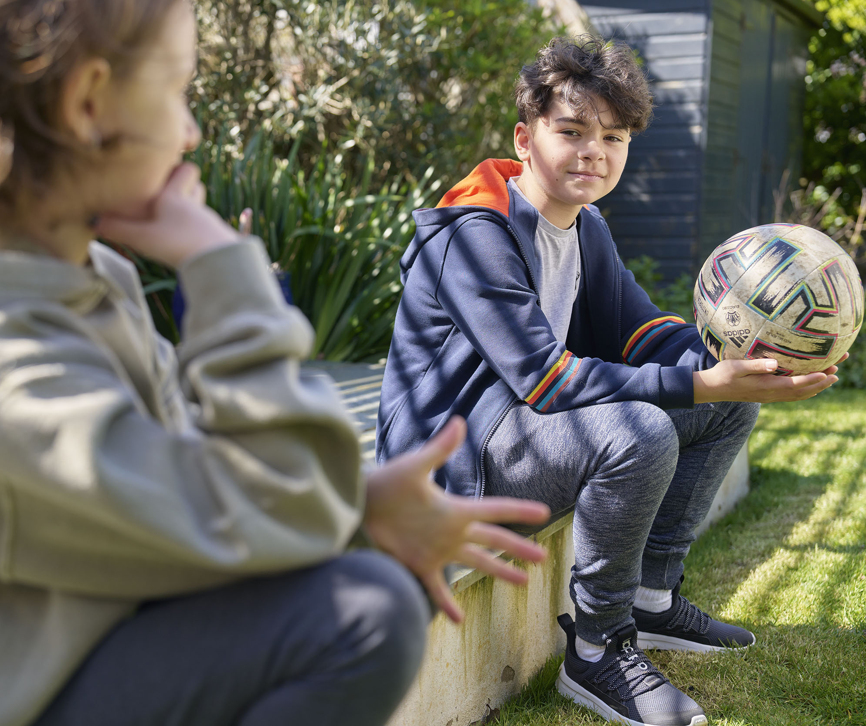
What might be the particular impacts for boys?
Believe they are not allowed to be victims
More prone to act out and express anger – ‘boys don’t cry’
Believe they should have been able to fight off the abuser – may be proof they are physically and emotionally weak
May pick fights with other boys to prove their masculinity or compensate for own insecurities
Abuse by a female may increase their confusion – should have enjoyed it
Sexual identity confusion
Homophobia if abuser was male
Notes:
Read through slide and pick up any points not raised in the exercise

Slide 13

What might be the particular impacts for victims and survivors in ethnic minority communities?
Being ostracised from their families or communities following disclosure of abuse.
The loss of support networks that play an important role in helping victims and survivors to recover from child sexual abuse.
“Support is so central because, for a lot of us and a lot of people that I know, we’ve been ostracised from our families. There’s no one we can talk to about it.” (Female focus group participant)
(IICSA, June 2020)
Notes:
Main points:
What might be the particular impact for Victims in Ethnic Minority Communities?
Simple read through of slide.
Additional information:
Further reading offer link to
https://www.iicsa.org.uk/publications/research/child-sexual-abuse-ethnic-minority-communities

Slide 14
“People don’t talk about it”
Child sexual abuse in ethnic minority communities, (IICSA, 2020)
Societal & Institutional Influences
Education and awareness
Media
Stigma associated with child sexual abuse
Stereotyping and racism in society
Institutional racism
Inaccessible services
Lack of culturally-sensitive services
Identification and disclosure
Responses to child sexual abuse
Support for the victim and survivor
Differences in understanding of child sexual abuse
Ideas about gender
Shame
Honour
Pride
Secrecy and denial
Mistrust of institutions
Community reputation prioritised of victim’s needs
Community Influences
Notes:
Main points:
Taken from the research People Don’t Talk About it: ‘The research considered three areas: barriers to disclosure; experiences of institutions; and support for victims and survivors. As context to these areas we also considered understandings of what constitutes child sexual abuse and wider attitudes to child sexual abuse among ethnic minority communities. The research findings are set out under these four headings below. In reality, we found these areas to be strongly linked together by underlying themes that we have characterised as relating to society and institutions, and to communities and culture. These reinforce each other and influence how child sexual abuse in ethnic minority communities is identified, disclosed and responded to and how victims and survivors are supported’.
Additional information:
read “People don’t talk about it”: Child sexual abuse in ethnic minority communities - Executive summary | IICSA Independent Inquiry into Child Sexual Abuse
Quote from the research ‘the social worker was white, okay, and she said to me, ‘This is not sexual abuse. This is your culture’. Even today, I’m so traumatised by this.” Female focus group participant.

Slide 15
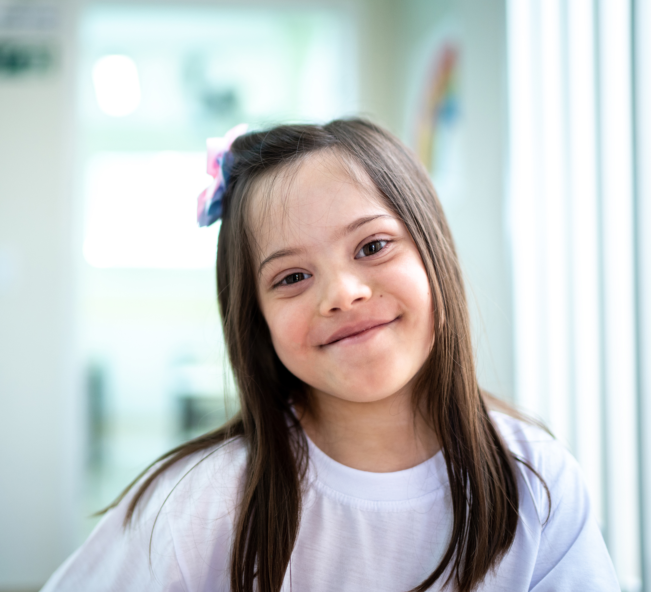
Impacts for disabled children
Impacts are not so well known because we often miss the signs and indicators in disabled children
Evidence in relation to the link between severity of impairment and risk to the child is mixed. There is an issue in relation to ack of data in this area
As a result, there are problems in having clear information to inform service design
There is a lack of up-to-date national guidance for all practitioners across mainstream and specialist services
Notes:
Read though slide

Slide 16
The impact of discrimination and oppression: in society, institutions and professionals on response
Cultural stereotypes & racism
Disability
Gender
Sexuality
Notes:
Main points:
The context in which children and families live important in addressing child sexual abuse ;
Cultural stereotypes and racism can lead to institutions and professionals failing to identify and respond appropriately to child sexual abuse. They can also make it more difficult for individuals from ethnic minority communities to disclose and speak up about such abuse; IICSA’s research: “People don’t talk about it”;
Intersectionality – example:
We understand the interconnected nature of social categorisations such as race, class and gender and the interdependent systems of discrimination that exist between them. For example:
Tia is a 15-year-old girl with a learning disability, living in a Traveller community. Tia identifies as Lesbian. Tia has been sexually abused by her uncle for 3 years.
Tia lives in a Traveller community which are often Closed Communities (i.e. insulated from wider mainstream society with strong social ties based on culture, heritage, religion and language). The IICSA engagement report (2021) report that groups such as the Romany, Irish Traveller, Ultra-Orthodox Jewish and some South Asian diaspora communities experience additional barriers to disclosure, particularly around separate religious and internal support and justice systems. They also report that community leaders sometimes restrict access to external support services in order to protect the community and culture from outside influence or harm.
Travelling communities often opt out of sending their children to school, preferring to home educate children. Those children who do attend school do not always attend regularly and/or are removed from school at a young age (IICSA, 2021). Consequently, these children may have limited opportunity to learn about sexual development and healthy relationships within a school environment. Furthermore, as a child with a learning disability in a ‘closed community’, she may have less access to services who often fail to reach out to disabled children in marginalised groups, compounding a sense of isolation.
Professionals who are not from the traveller community may have preconceived ideas and biases about how children will behave and present. For example, if Tia is behaving in a highly sexualised manner towards adults, which is a potential indicator of sexual abuse, professionals may assume that she is doing this because of the community she is from, rather than because she is being sexually abused.
Tia is female - Girls from travelling communities rarely talk about sexual abuse as sexual activity outside of marriage would be considered to make the girl ‘impure’ and no longer suitable for marriage. This creates an additional barrier to Tia telling professionals what is going on for her.
Tia identifies as Lesbian – the traveller movement recognise that many people in travelling communities hide their sexuality for fear of rejection from their family and/or their community.
As you can see, Tia faces a number of interconnected barriers to talking about sexual abuse.
Adultification as an issue – Social, developmental and contextual processes that expose youths to inappropriate adult knowledge and assuming of extensive adult roles and responsibilities.
Disabled children 3.4 times more likely to be abused, but less likely to be subject to safeguarding processes; institutions have not worked out what 3.4 times more protection looks like;
Little research regarding LGBT+ children and their families affected by CSA but do know discrimination in statutory services exists;
Do know that gender and discrimination is an important factor in CSA which needs addressing; boys under represented for example;
What is also important is to consider how these experiences of discrimination and oppression overlap and compound each other in the context of service provision and best practice.

Slide 17
How impacts may differ
How might context affect impacts and responses?
Consider:
Online child sexual abuse
Institutional sexual abuse
Intrafamilial sexual abuse
Any others you can think of
Notes:
Main points:
Small group activity – 10 mins
Divide the group into smaller groups using breakout rooms.
Ask each group to nominate someone to feedback to the wider group
Trainer note – the following slides give some information about how children may experience impacts – depending on what is covered by the groups, you may not need to go into detail in the following slides
Discussion points
Impact of Online Abuse.
Trainer Note - Start a discussion about whether people think online abuse has more or less impact than abuse in the real world.
Then go through some of the differences:
In the Room.
Online.
Ask about impact online and contact offices. Maybe give an example of 13 year old girl abused by uncle and 13 year old girl abused online by touching self and sending photos. Remember the online means the images are then out there for ever, the contact one is made safe once tells, the online on it will always be there. For a lot of young people it happens in their bedroom which should be safe. Sometimes people think online sexual abuse is less impactful but we need to be thinking about this more.
In person - committed by another’s hand.
Online - Committed by own hand.
In person - physically and/ or emotionally forced by another.
Online - Emotionally persuaded/ threats by another.
In person - you can see who is abusing you and there is a context to the relationship.
Online - you do not know who is abusing you.
In person - definitive timelines, at a time and place.
Online - exists online forever, abuse continues by others, at any time and any place.
In person perception – they were harmed
Online perception – they did it to themselves.

Slide 18
Online sexual abuse - differences in the environment
Use of ‘everyday’ objects
Usual environmental restrictions don’t apply
Ability to switch off
Notes:
Main points:
Use of ‘everyday’ objects – the person abusing the child may encourage them to use objects in their bedroom to penetrate themselves. This then means there is a constant physical reminder around the child
Usual environmental restrictions do not apply. This may allow the person abusing the child to push boundaries even further - as they are not in the room, the person abusing the child may push boundaries much more, take more risks and engage in more paraphilia/harm. They may also encourage the child may engage in much riskier behaviour
The perceived distance created by the online world can lead the person abusing the child to switch off from what is actually happening much more easily

Slide 19
Physical impacts caused to children from online abuse
Growing concern in relation to the physical impacts on children when a child is groomed to harm themselves for the sexual satisfaction of the offender
Alexander McCartney was prosecuted by the Public Prosecution Service for Northern Ireland (PPS) after he groomed and sexually abused thousands of young girls from a number of countries from his home in Northern Ireland.
The 185 charges he faced and eventually pleaded guilty to included the manslaughter of an American girl who took her own life as a direct result of the online abuse he inflicted on her
Notes:
Read through slide

Slide 20

The implication of a child’s images being shared
Notes:
Main points:
Talk through Ella’s story from National Centre for Missing and Exploited children (NCMEC):
Ella* was sexually abused by a family member from the age of five, for a period of seven years. Ella’s abuser took images and videos of the abuse and distributed them online. NCMEC traced the location of the abuse to an area in the Western United States and referred the case to local law enforcement. Police located and rescued Ella, and the person who harmed was convicted and sentenced.
Although the person who caused the harm is now in prison, images and videos of Ella continue to circulate, and other people who sexually harm children continue to harass her online. Her caregiver described the trauma created by resharing: “There’s this sense that the offender going to prison is the end but it’s not...At first, I was oddly grateful for the photos because that’s what got them caught. But the images are still out there, they don’t go away. Tens of thousands of people have seen her... even 10 years later.” Over the years, Ella has received thousands of victim notifications from the government about cases involving her images and videos.
Even in adulthood, this re-victimisation has left Ella in need of continuous therapy. Ella is now drawing on her experience to help others. She serves as a survivor consultant, helping to inform the development of NCMEC’s support resources and building new programme services for other survivors.
This story serves as a stark reminder of the ongoing impact for children and adult victim- survivors of online abuse. It captures the continuing loss of control and agency over their body and the exposure and humiliation of the knowledge that thousands of other people may be viewing their abuse.
Additional information:
The National Centre for Missing and Exploited Children (NCMEC) is a private, non-profit corporation.
Its mission is to find missing children, reduce child sexual exploitation, and prevent child victimisation.
https://www.missingkids.org/HOME

Slide 21
The dynamics of institutional sexual abuse
Victim
Institution
Person who sexually harms
Institutional child sexual abuse needs to be understood in the context of the dynamics between factors relating to those who sexually harm, the victims, and the institution itself (Blakemore et al, 2017).
Notes:
Main points:
Read through slide - The Dynamics of institutional sexual Abuse.
Additional information:
https://www.csacentre.org.uk/resources/key-messages/institutional-csa/

Slide 22
The dynamics of institutional sexual abuse
Victim- survivors of institutional abuse often describe their abusers in terms of the power and control they exerted over them.
In sport, coaches can exert a great deal of power over children, by virtue of their role and because their power and control is sustained by the motivations of young athletes to succeed.
A coach can control many aspects of a young athlete’s life - medical treatment, diet, social activities and sexual behaviour, and such control is normalised within training regimes.
The dynamics of abuse in sports, involving dependency, abuse and guilt, have been likened to those of domestic violence.
In religious settings, the power of those who abuse may be enhanced by their position as ‘God’s representatives’.
Abuse by a trusted and admired mentor or spiritual leader can leave victims with a profound sense of betrayal.
Notes:
Main points:
The dynamics of institutional sexual Abuse - simple read through of slide.
Additional information:
https://www.csacentre.org.uk/resources/key-messages/institutional-csa/

Slide 23
The dynamics of institutional sexual abuse
A key feature is the behaviour of the institution itself, both in failing to prevent the abuse and in its response to disclosure.
The trauma of the abuse is frequently compounded by responses from people associated with the institution, who find it impossible to believe that such abuse can have occurred or who deny the abuse in order to protect the institution (IICSA Research Team, 2017).
Disclosures from victims- survivors have frequently been met with denial, concealment and victim-blaming by institutions seeking to protect themselves from litigation or loss of reputation (Spröber et al, 2014).
This institutional behaviour can re-victimise survivors and traumatise them further (Astbury, 2013).
Notes:
Main points:
Read through slide

Slide 24
Impact on survivors of institutional sexual abuse
A sense of ‘institutional betrayal’:
The sense of betrayal compounded if the victim- survivor feels betrayed not only by the person/people who harmed them but also by the institution itself.
Institutional betrayal is associated with increased levels of anxiety, trauma symptoms and dissociation for victims - survivors of abuse, especially when they have trusted and been dependent on the person who harmed them.
For example, the abuse of children by priests and others in churches has been described as ‘a unique betrayal’ (Guido, 2008) which harms victims’ spiritual wellbeing by undermining their previously deeply held beliefs (Walker et al, 2009; Wurtele, 2012; Mart, 2004; Wolfe et al, 2003).
Impact on help-seeking
Concepts of masculinity
Impacts on people close to the victim
Notes:
Additional information:
Some specific issues for understanding the impacts of institutional abuse include the following:
Impact on help-seeking:
The sense of betrayal and mistrust of organisations and authorities may make some survivors unwilling to seek support from other organisations (Breckenridge et al, 2008; Kantor et al, 2017).
Concepts of masculinity:
Many survivors of institutional abuse are male, and this has implications for both the abuse’s impact on them and the availability of appropriate support (Brackenridge, 2001; Hartill, 2014).
Dominant concepts of masculinity portray men as ‘naturally’ strong, active, autonomous beings, so male survivors may feel extreme shame over their victimisation – making them reluctant to disclose or seek support, and affecting their self-image, mental health and relationships (Fogler et al, 2008; Easton et al, 2014).
Impacts on people close to the victim:
Blakemore et al (2017) describe institutional CSA’s ‘vicarious impacts’ on the lives and wellbeing of those connected to victims/survivors, such as family members, friends, partners and children (Roberts et al, 2004).
These impacts can be experienced both in the immediate aftermath of abuse and many years later (Morrison et al, 2007). For example, victims’ family members may experience grief, guilt, shame, and rage at having been unable to prevent abuse, having not recognised its occurrence, or having contributed to the victim’s engagement in the institutional context where the abuse occurred (Bennett et al, 2000).
Prior experience of non-institutional abuse. Some children (e.g. those in residential care or custody) may previously have been abused in other contexts, such as within the family (Sayer et al, 2018).

Slide 25



Reflections
One thing you have learnt from this session
One thing you will share with your colleagues
One thing you will take forward in your own practice
Notes:
Ask the group to make a note of one thing they have learnt from the session, one thing they will share with colleagues, and one thing they will take forward in their own practice
Ask them to pick one of these to share in the chat
Give everyone 5 mins for this

Slide 26
Stop It Now Helpline
If you are worried about your own thoughts or behaviours or are worried about the behaviours of someone around you, you can contact the Stop It Now Helpline for free, confidential advice:
0808 1000 900
Notes:
Read through slide

Slide 27
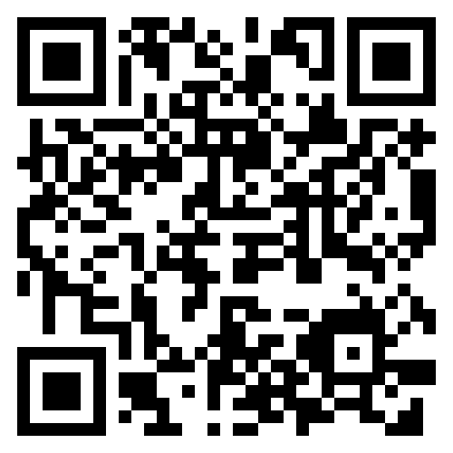
Find a support service
Being able to access support, as a child, young person or adult, is crucial to mitigating the impacts of child sexual abuse.
To help make this easier, the CSA Centre has created a directory containing over 350 child sexual abuse support services in England and Wales.
The accessible, searchable Support Services Directory is a simple way for victims and survivors, their families, or professionals, to find services that can help.
Find support services and get help today.
csacentre.org.uk/get-support/
Notes:
People can search by location, or by clicking on a region on the map. It contains support services for all those who may be impacted by child sexual abuse, including children and young people, parents and carers, and adult victims and survivors of child sexual abuse.
It is completely confidential to access - no sign-up is required, and no information is saved when people search for support.
Those seeking help can also find local and national services offering focused support for women and girls, men and boys, LGBTQ+ people, disabled people and for people specifically from ethnic minority backgrounds.
It’s a particularly valuable tool for professionals working with those affected by childhood sexual abuse to quickly find and recommend support for the children and adults they work with.
Sadly, as evidenced in the CSA Centre’s Support Matters report, there remains a shortage of support services for those who have experienced child sexual abuse.
Whilst getting support can play a large role in victims and survivors feeling able to move forward from sexual abuse in childhood, children and adults are still waiting too long to receive help.
In addressing this, the new support services directory can also be used, alongside our Data Insights Hub, to better understand the support landscape in England and Wales, for commissioners of services and those seeking change.

Slide 28
Any questions?
For more information please contact:
info@csacentre.org.uk

Slide 29
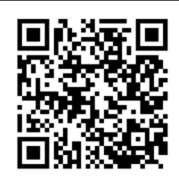
Let us know!
Please take the time to complete this short survey, in relation to the content of today’s module.
Please do report any urgent concerns / attendance issues directly to plp@csacentre.org.uk
Thank you for your participation!
Notes:
COPY INTO CHAT IF UNABLE TO USE QR CODE: Practice Leads Programme (PLP) Participant Sessional Survey: https://www.surveymonkey.com/r/PLPParticipantsurvey
FACILITATORS! Don’t forget your survey too: Practice Leads Programme (PLP) Facilitator Sessional Survey: https://www.surveymonkey.com/r/PLPFacilitatorsurvey

